Slide 1


AI-Enhanced E-Learning Platform for the Hearing impaired children
24-25j-281

Slide 2


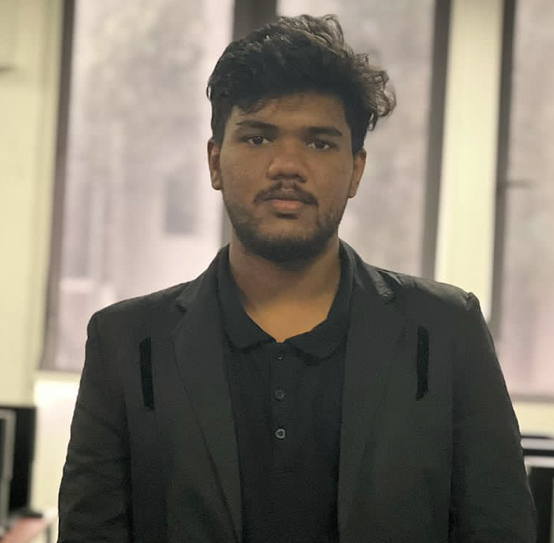
Team Members
Saliha Rizan
IT21311840
Z.F. Sahla
IT21159558
M.S.M Shazny IT21173622
Supervisor – Ms. Thamali Kelegama
Co- Supervisor – Ms. Vindhya Kalapuge
External Supervisor – Ms. Fathima Roshan Shafeedha Rizan
24-25j-281

Slide 3
Saliha Rizan
IT21311840
M.S.M Shazny IT21173622
Z.F. Sahla
IT21159558

Slide 4
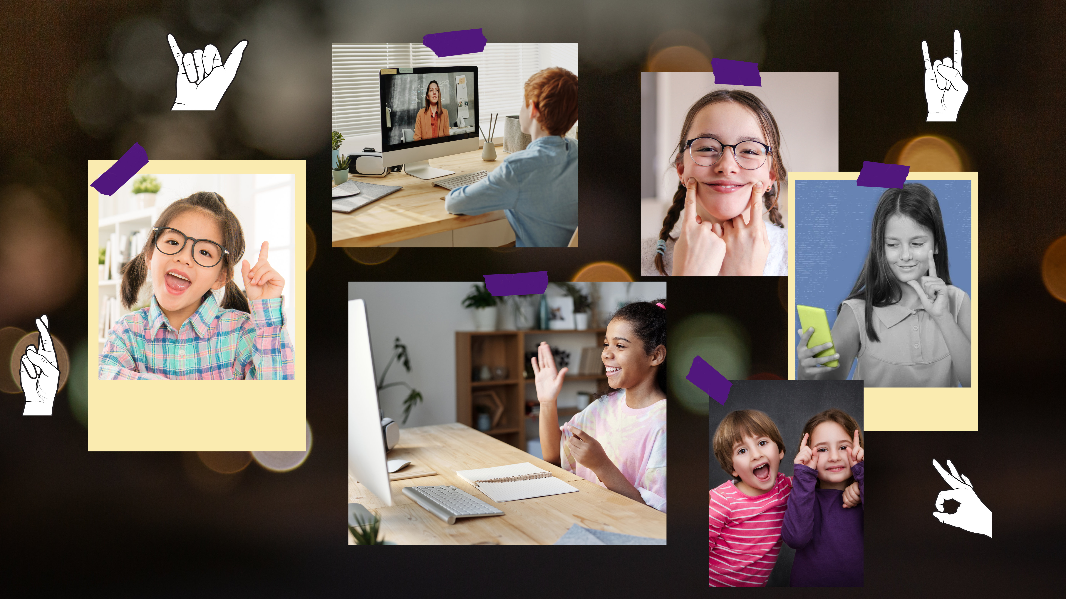
Introduction
This research addresses the significant barriers encountered by hearing-impaired children in accessing traditional e-learning environments.
Emphasizes the need for a tailored learning experience utilizing AI to translate educational content into sign language, ensuring inclusivity.
The solution integrates advanced technologies such as augmented reality and machine learning to enhance interaction and learning outcomes.

Slide 5



Slide 6

01
02
03
04
05
What are the most effective machine learning models for real-time gesture recognition in ASL learning?
How can augmented reality (AR) enhance the learning of American Sign Language (ASL) gestures in children with speech disorders?
How can performance prediction and personalized course recommendations optimize learning paths for children with speech disorders?
What is the impact of AI-driven interaction, such as chatbots and gesture-based communication, on children's speech therapy engagement and outcomes?
How can a real-time translation system bridge the gap between educational content and hearing-impaired children by providing captions and synchronized sign language?

Slide 7
Main Objective
Sub Objective
AI-enhanced e-learning platform specifically designed for students aged 4 - 12, those who are hearing-impaired. This platform will leverage Augmented Reality, real-time translation technologies, and adaptive AI assistance to create a fully inclusive and personalized educational experience. It aims to facilitate seamless access to learning materials through real-time captions, sign language interpretation, and interactive support, while dynamically adapting to the individual learning styles and needs of young learners to enhance their engagement and educational outcomes.
Interactive ASL learning sessions using AR and Machine Learning
Real-Time Translation of Educational Content to captions, sign language and providing summary.
AI powered personalized learning assistant with sign language support
Objectives

Slide 8
Main Objective
Sub Objective
AI-enhanced e-learning platform specifically designed for students aged 4 - 12, those who are hearing-impaired. This platform will leverage Augmented Reality, real-time translation technologies, and adaptive AI assistance to create a fully inclusive and personalized educational experience. It aims to facilitate seamless access to learning materials through real-time captions, sign language interpretation, and interactive support, while dynamically adapting to the individual learning styles and needs of young learners to enhance their engagement and educational outcomes.
Interactive ASL learning sessions using AR and Machine Learning
Real-Time Translation of Educational Content to captions, sign language and providing summary.
AI powered personalized learning assistant with sign language support
Notes:
Main Objective: Our main goal is to develop an AI-enhanced e-learning platform designed specifically for hearing-impaired students aged 4 to 12. The platform integrates augmented reality, real-time translation technologies, and adaptive AI assistance to create an inclusive and personalized educational experience.
It ensures seamless access to learning materials through real-time captions, sign language interpretation, and interactive support. At the same time, it adapts dynamically to the unique needs of each child to improve their learning engagement and outcomes.
Sub-Objectives: To achieve this, we focused on three key sub-objectives:
Creating interactive ASL learning sessions using AR and machine learning.
Developing real-time translation of educational content into captions, synchronized with sign language and summaries.
Designing an AI-powered personalized learning assistant with sign language support.
These objectives together aim to bridge the gap in education for hearing-impaired children by making learning accessible and enjoyable.

Slide 9
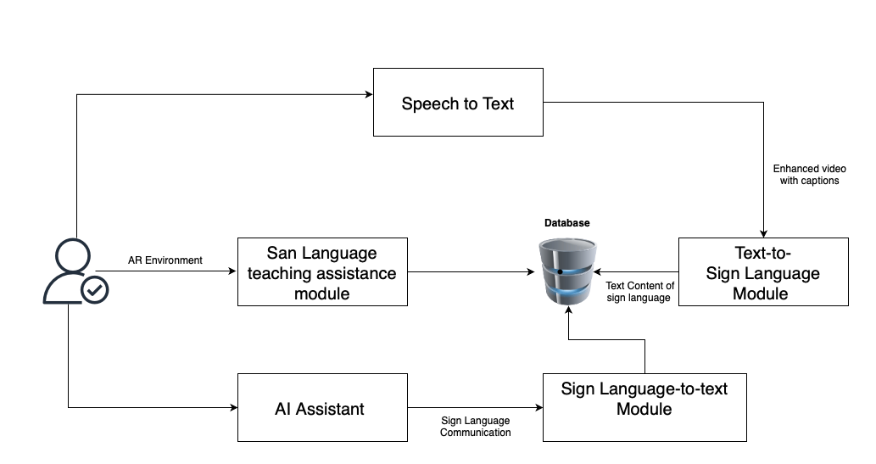
System Diagram

Slide 10
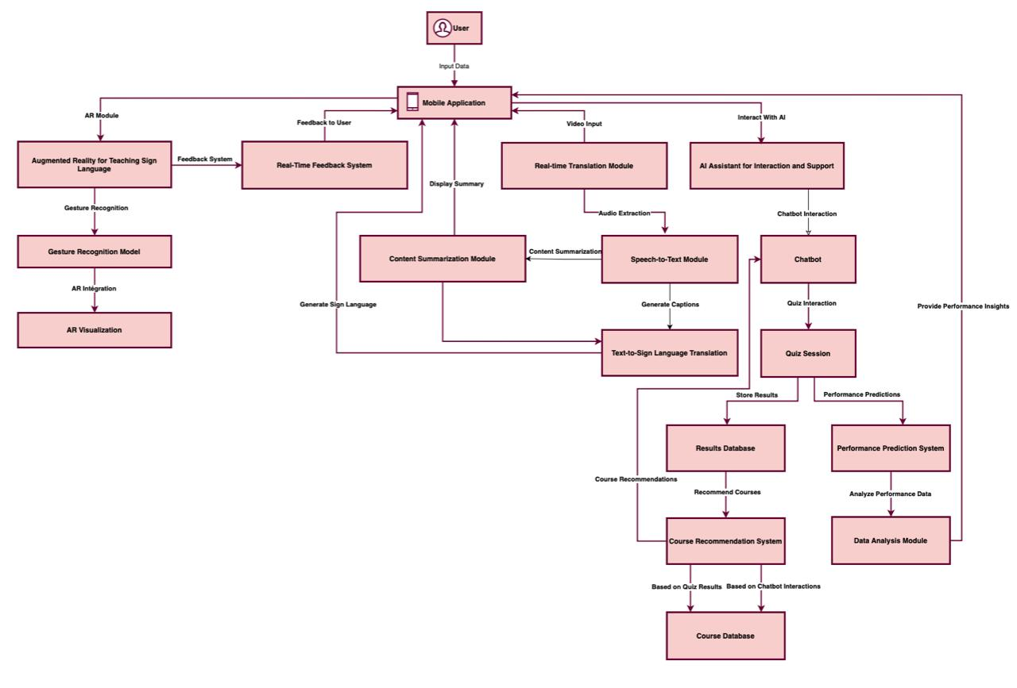
Architecture Diagram

Slide 11
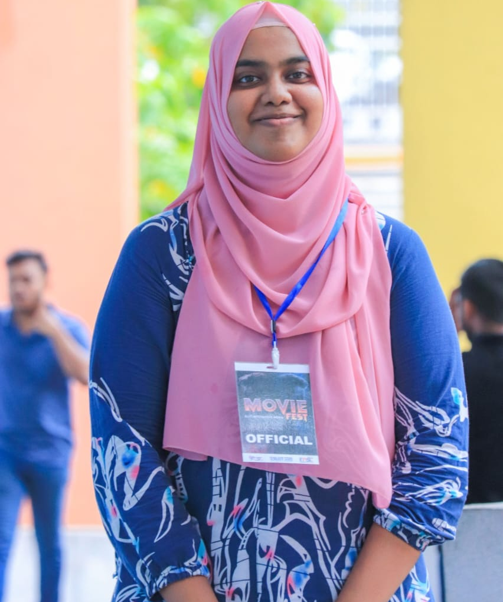
Rizan S - IT21311840
Specialization : Interactive Media
Interactive ASL learning sessions using AR and Machine Learning
11
Rizan S – IT21311840
Notes:
Good Evening Panel.. I’m Rizan S, and my component is 'Interactive ASL Learning Sessions Using AR and Machine Learning'. The goal of this component is to create an engaging, interactive platform to help users learn American Sign Language (ASL) through augmented reality (AR) and machine learning (ML).

Slide 12

Background
AR Module to teach sign language with virtual hands performing gestures.
Real-time feedback on students' gestures.
Curriculum divided into 3 levels: Beginner, Intermediate, and Advanced.
Combines AR and ML to create an engaging, interactive learning experience.
12
Rizan S – IT21311840
Notes:
Now, let me explain the background of my component.
Our system uses augmented reality (AR) to teach sign language, where virtual hands perform the signs. We also provide real-time feedback on the users' gestures, helping them learn more effectively. The curriculum is structured into three levels: Beginner, Intermediate, and Advanced, making it suitable for learners at different stages. By combining AR and machine learning (ML), the goal is to create an engaging and interactive learning experience for users.

Slide 13
Research Gap
Most sign language apps use pictures or videos but don’t allow interaction.
Many apps don’t provide real-time feedback, so you might not know if you're doing it right.
This project is different:
Uses Augmented Reality (AR) to show virtual hands performing signs.
Provides real-time feedback to tell you if you're doing the signs correctly.
Allows you to practice sign language in a fun, interactive way.
Notes:
The research gap for my component is that most sign language apps use pictures or videos but don’t let users interact. Also, many apps don’t give real-time feedback, so users aren’t sure if they’re signing correctly.
Our project solves this problem by using Augmented Reality (AR) to show virtual hands performing the signs. We also give real-time feedback to help users improve their signing.
This makes learning more fun and interactive, allowing users to practice ASL in a better way.

Slide 14

Specific & Sub Objectives
Create an app that shows 3D sign language signs using AR.
Let you practice making signs with your hands.
Provide real-time feedback on whether the sign is correct.
Build a colourful AR app to display sign language signs.
Ensure the app can detect hand gestures in real-time.
Show the correct sign language gesture in AR to copy.
Give feedback based on error detection.
14
Rizan S – IT21311840
Notes:
The main objectives of the project include:
Creating an app that displays 3D sign language signs using AR.
Allowing users to practice making signs with their hands.
Providing real-time feedback to let users know if their sign is correct.
Additionally, we want to build a colorful AR app, ensure the app can detect hand gestures in real-time, and give feedback based on error detection."

Slide 15
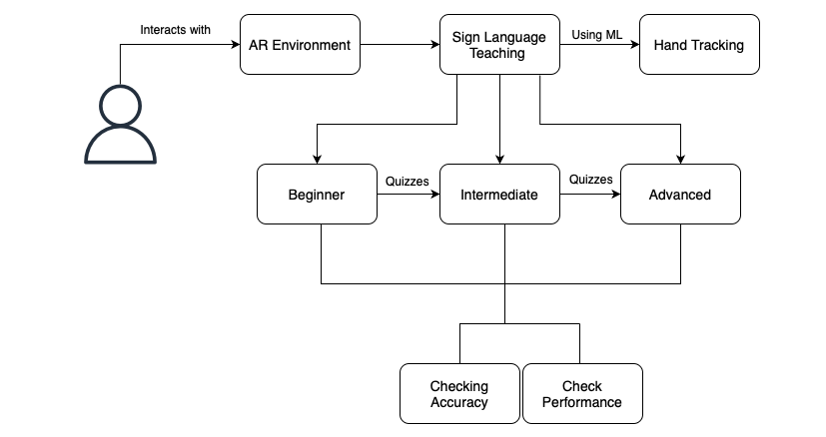
System Diagram
Rizan S – IT21311840
Notes:
Here’s an overview of how the system works. The user interacts with the AR environment and learns sign language at different proficiency levels: Beginner, Intermediate, or Advanced. We use hand tracking and ML to teach and assess the user's performance. Based on the gestures, the system checks for accuracy and performance to help the user improve.

Slide 16
Workflow
Data Collection
Data Preprocessing
Model Training
Real-time Gesture Recognition
Feedback to User
Prediction
Video Frame Processing
Rizan S – IT21311840
Notes:
Let me take you through the workflow of my component... hmm... So, first, the data is collected. It contains ASL gesture data. And, once the data is collected, the system then checks and extracts the hand landmarks from the dataset using MediaPipe. Aaa... These landmarks are made up of 21 key points on the hand, which are used to identify the positions of the fingers in the frame. Each of these landmarks has x, y, z coordinates... hmm... The x, y, z coordinates of these landmarks are then extracted, and they serve as features for gesture classification.
And then, once the data is collected, it goes through preprocessing. The data is cropped and cleaned by renaming columns for clarity, removing unnecessary ones, and handling outliers using ISO (Isolation Forest) Method. This process ensures the dataset is prepared and ready for efficient model training.
Hmm, after the data is preprocessed, the cleaned dataset is used to train various machine learning models, like Random Forest, CatBoost, Gradient Boosting, and XGBoost. Among these models, CatBoost is chosen because it gives the highest accuracy and fastest speed, aaa, compared to the other models.
Once the model is trained, it’s ready for real-time use. So, if a user wants to practice ASL, they can open the web interface, which is connected via WebSocket for real-time communication. The system captures video frames one by one, processes each frame to detect the hand landmarks, and extracts the x, y, and z coordinates of the 21 key points—just like we did in the training phase.
Now, the WebSocket connection ensures that the captured data is sent in real-time to the backend. The system processes the extracted landmark coordinates and sends them to the trained model, which then predicts the ASL sign based on the hand's position in the frame.
Once the model receives the landmark data, it classifies the gesture and predicts the ASL letter.
The system then provides real-time feedback by analyzing the positions of the fingers and indicating which ones are correctly or incorrectly positioned.
Hmm, this feedback allows users to practice and improve their ASL skills with real-time gesture recognition. It helps users understand whether their hand positions are correct, providing a way to enhance their learning and performance over time.

Slide 17

Technologies Used
Estimated Technologies
Machine Learning Model – CatBoost, RandomForest, Gradient Boosting, XG Boost
Mobile Application - Flutter
Database - Firebase
Server - Fast API
3D Modelling - Blender
General Environment
Python
Google Colab
Github
17
Rizan S – IT21311840
Notes:
The technologies I’ve used for this project include:
Machine Learning Models like CatBoost, Random forest, Gradient Boosting, and XGBoost.
The mobile application is developed using Flutter.
I’ve used Firebase as the database, and Fast API for server-side operations.
Blender was used for 3D modeling. For the general development environment, I used Python, Google Colab, and GitHub.

Slide 18
Implementation
Rizan S – IT21311840

Slide 19
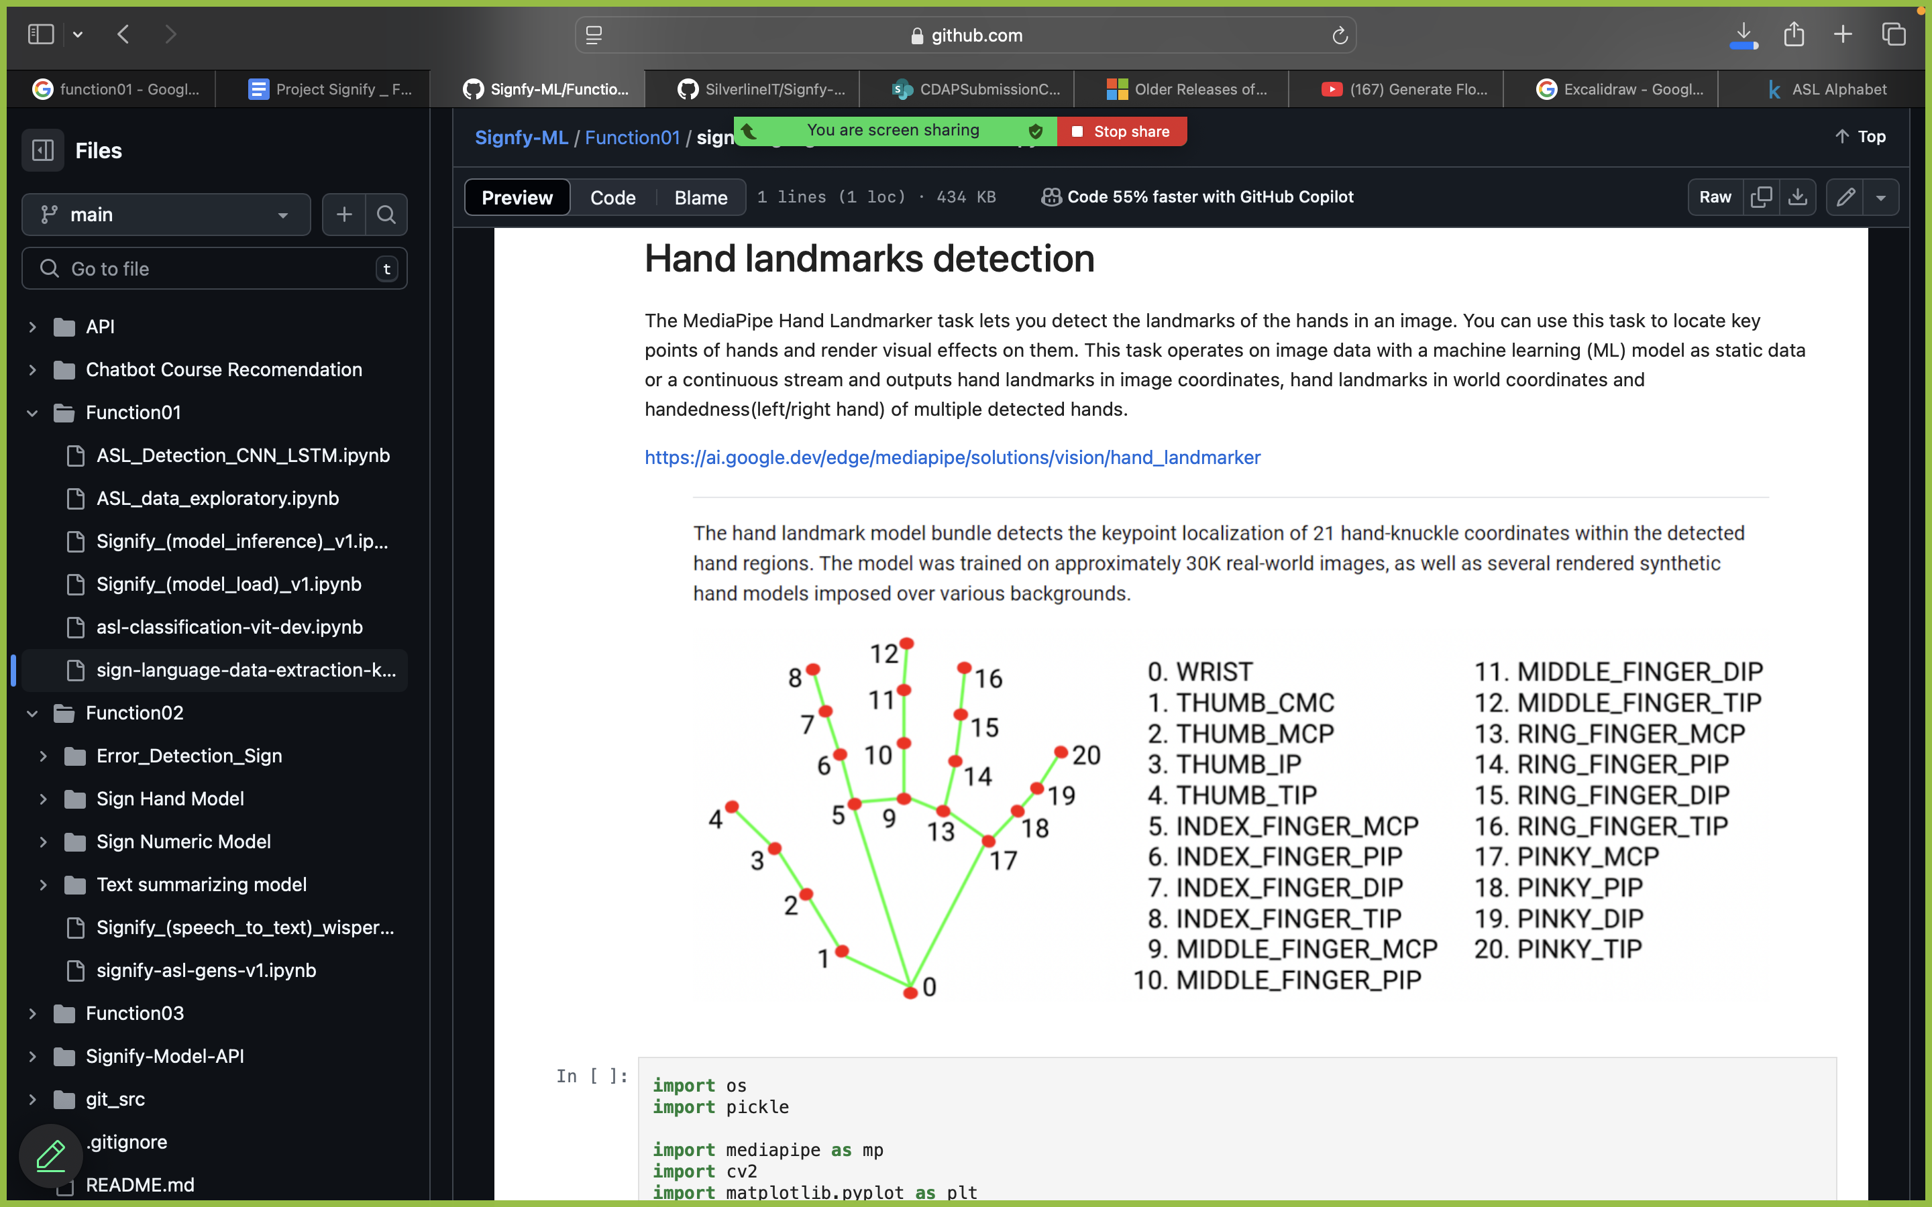
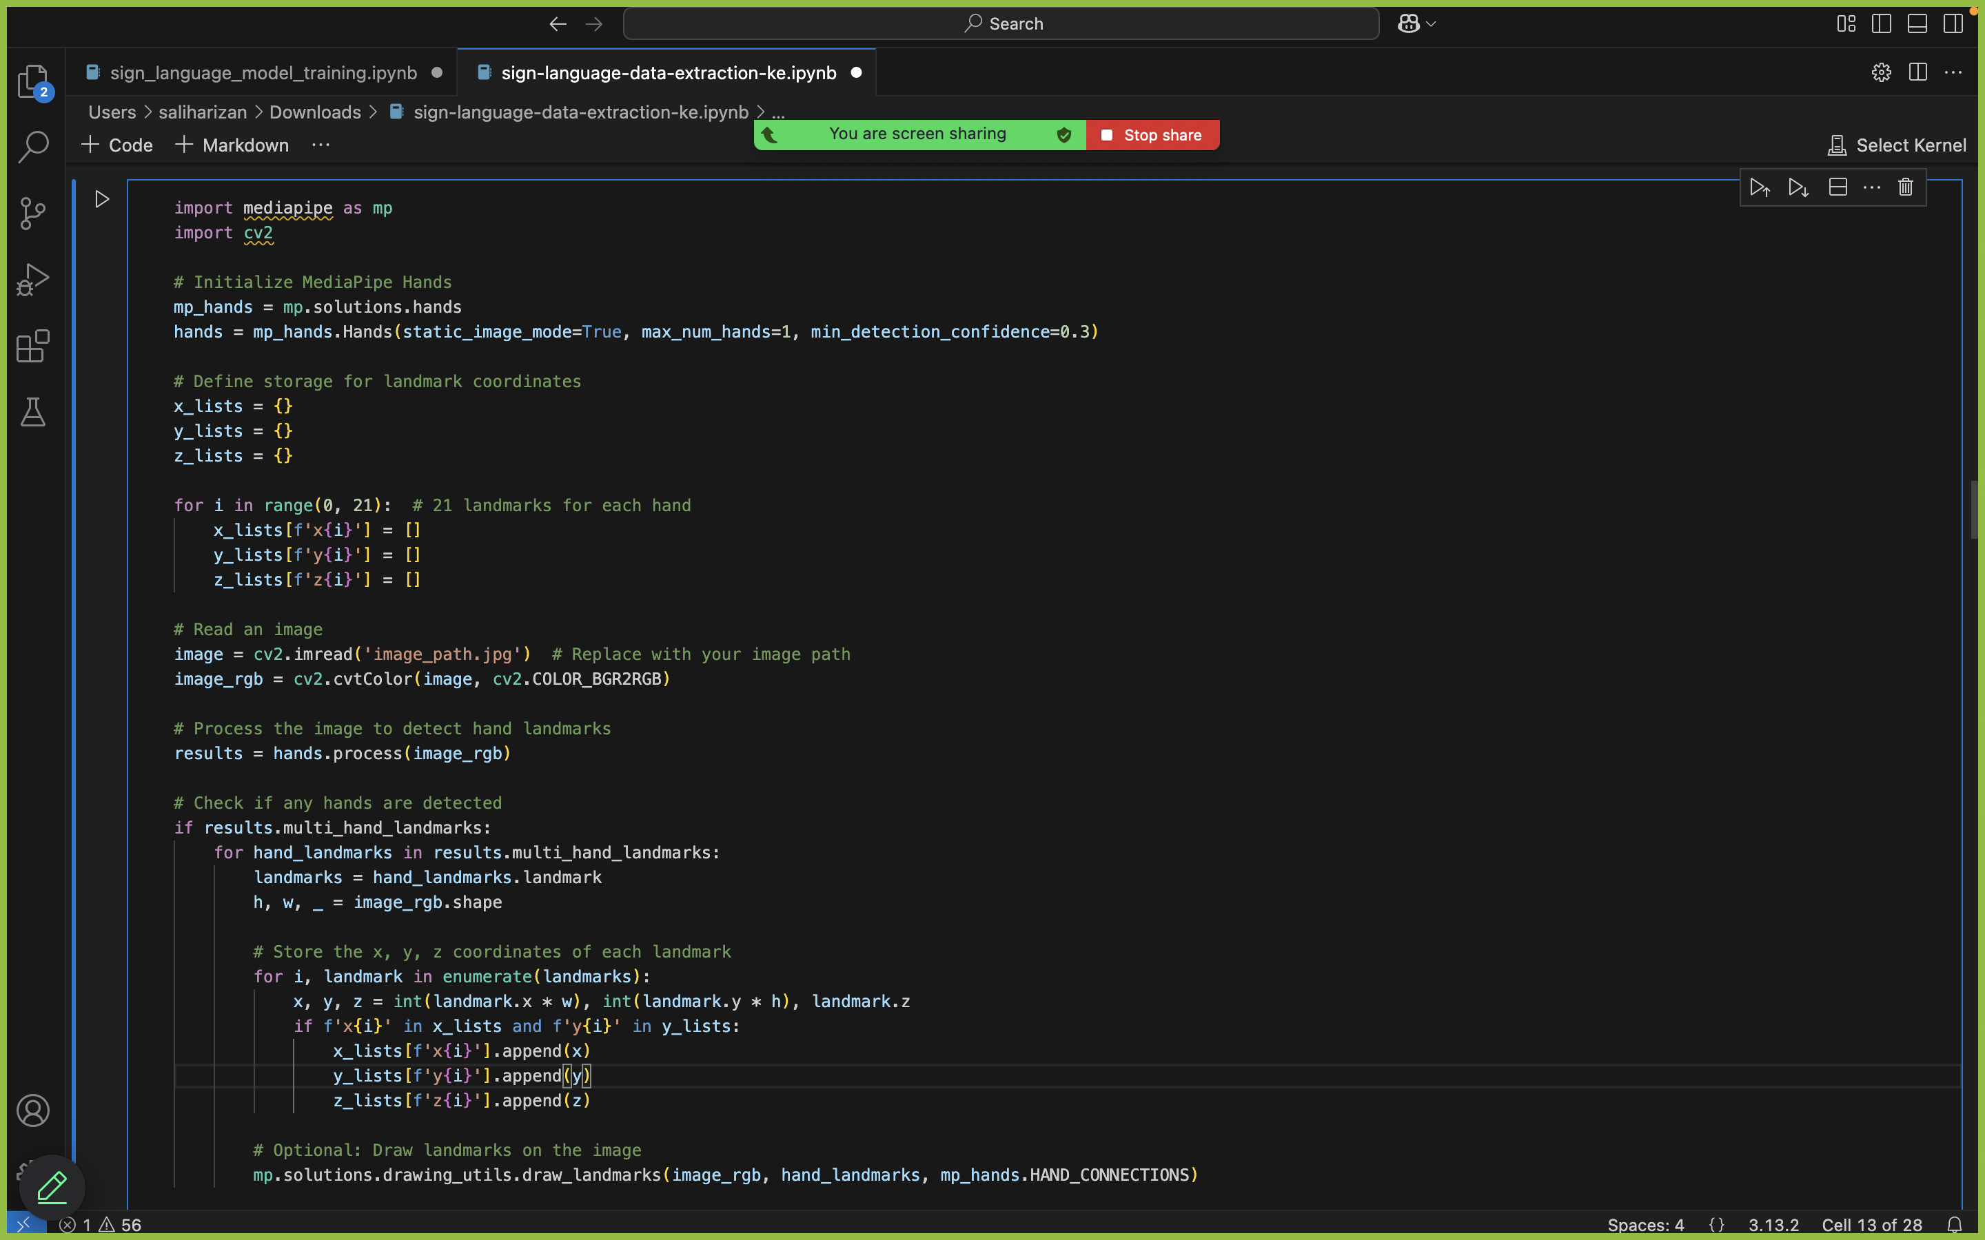
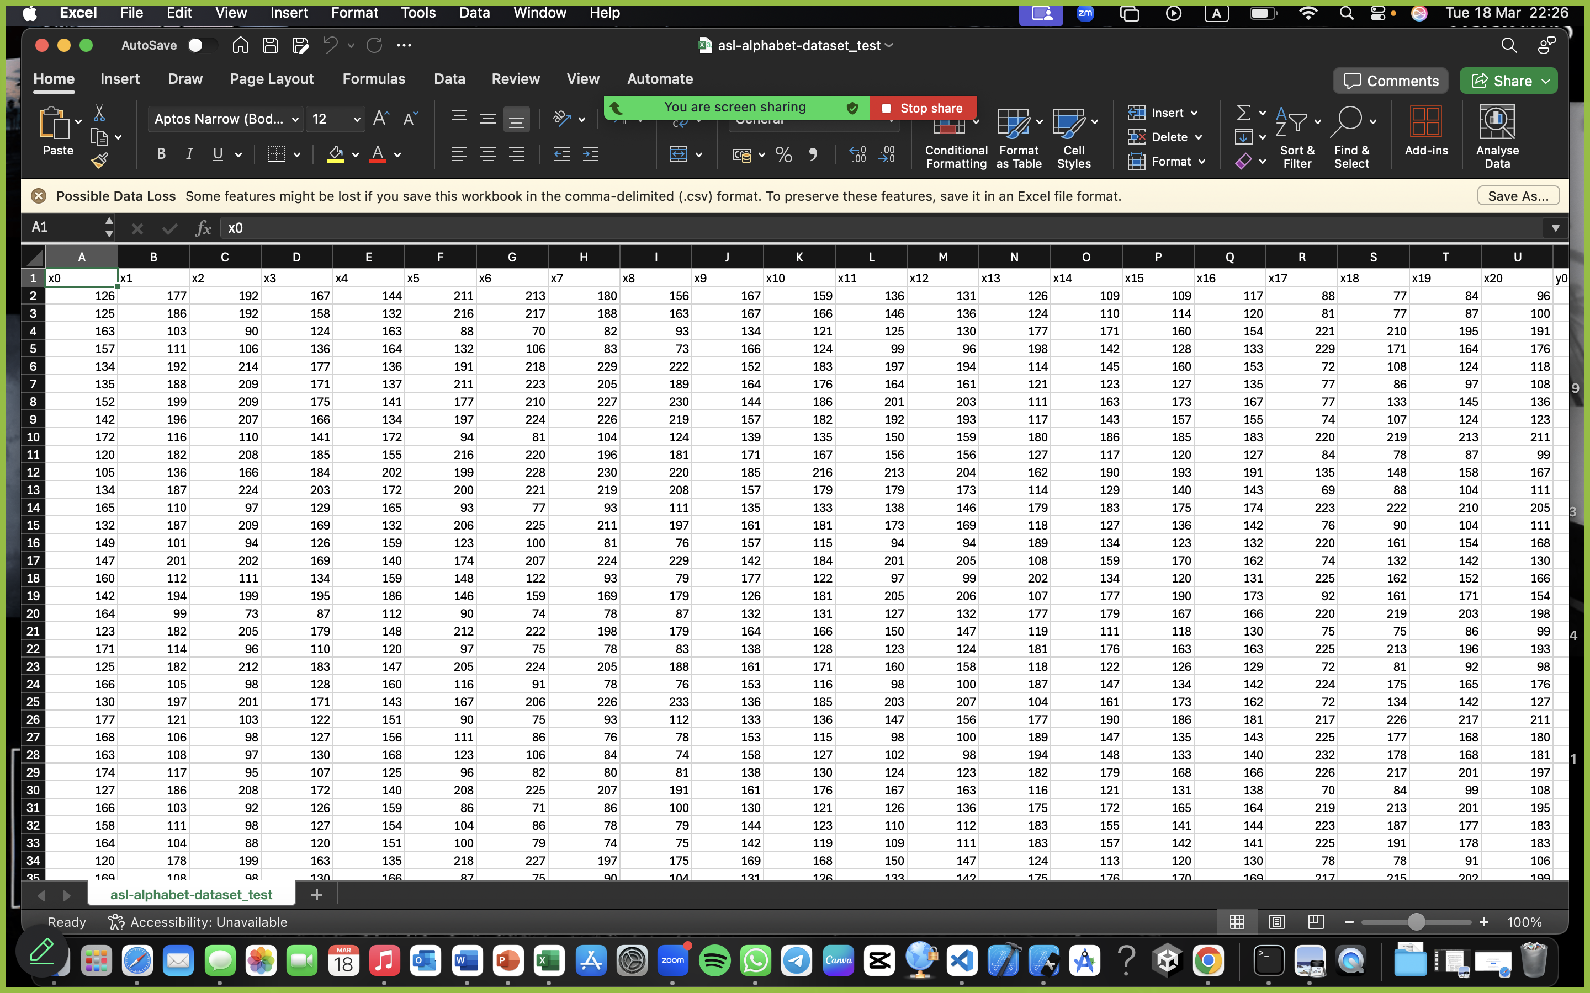
Data Extraction
Rizan S – IT21311840
Notes:
Let me explain the data extraction method I used. As I mentioned previously, this image shows the process of extracting the 21 key points from the hand. These key points include the wrist, each joint in the fingers, and the fingertips. The red dots represent these key points, while the green lines connect them.
The coordinates of each of these 21 points (x, y, and z) are extracted and used to track the hand's position and movement in 3D space. This data is essential for recognizing the ASL gestures accurately. The coordinates are then stored and used to train the machine learning model, enabling real-time recognition of hand gestures in the system.

Slide 20
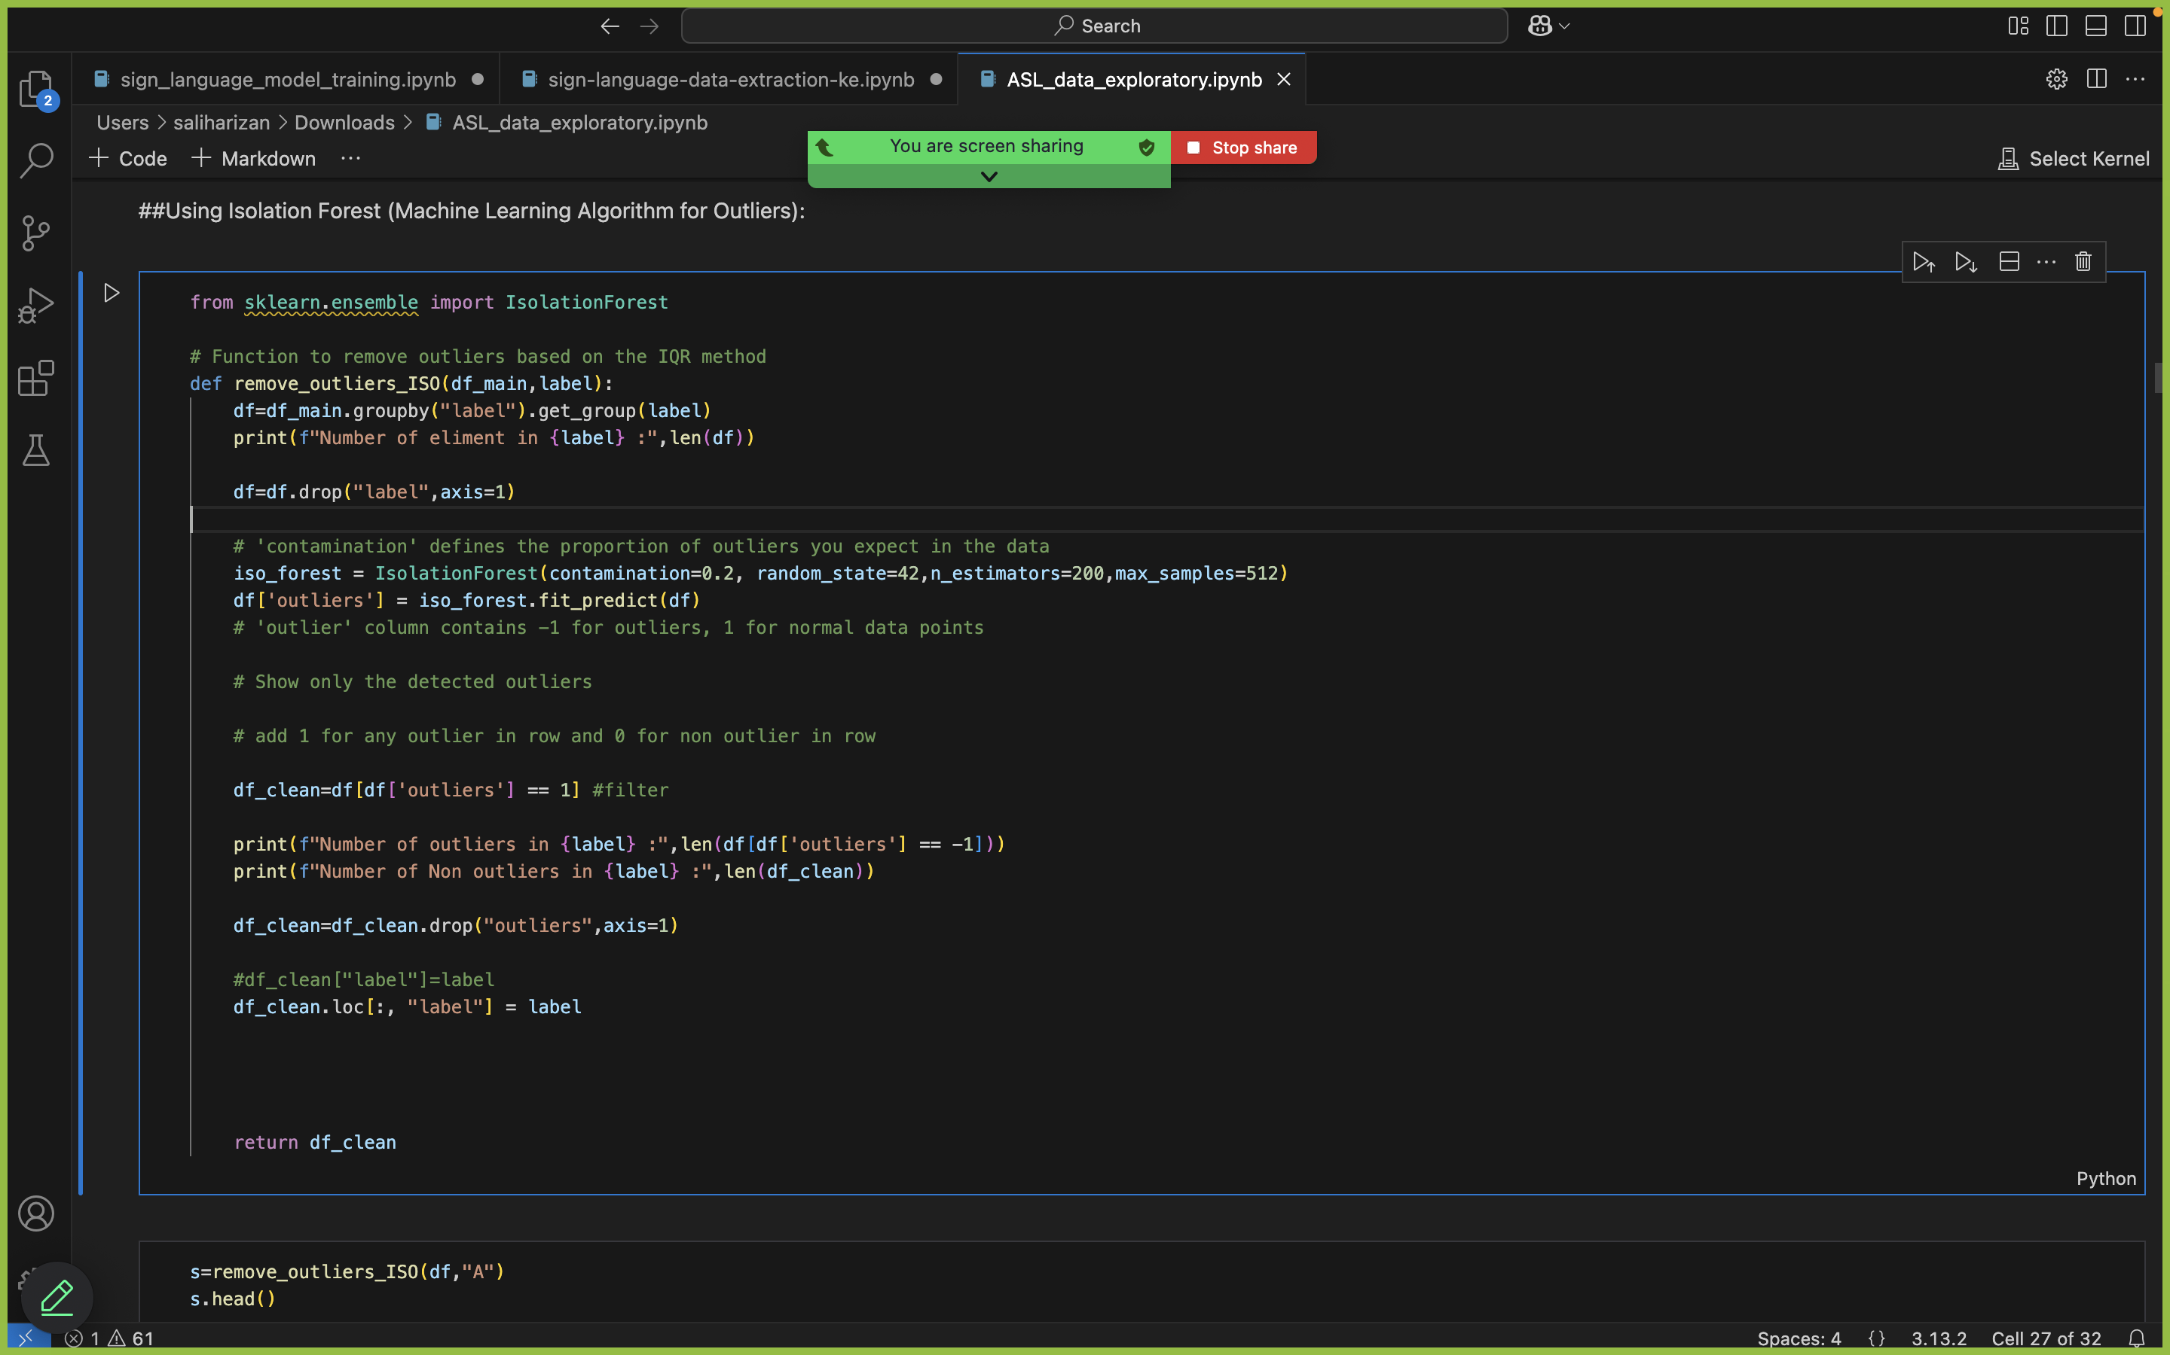
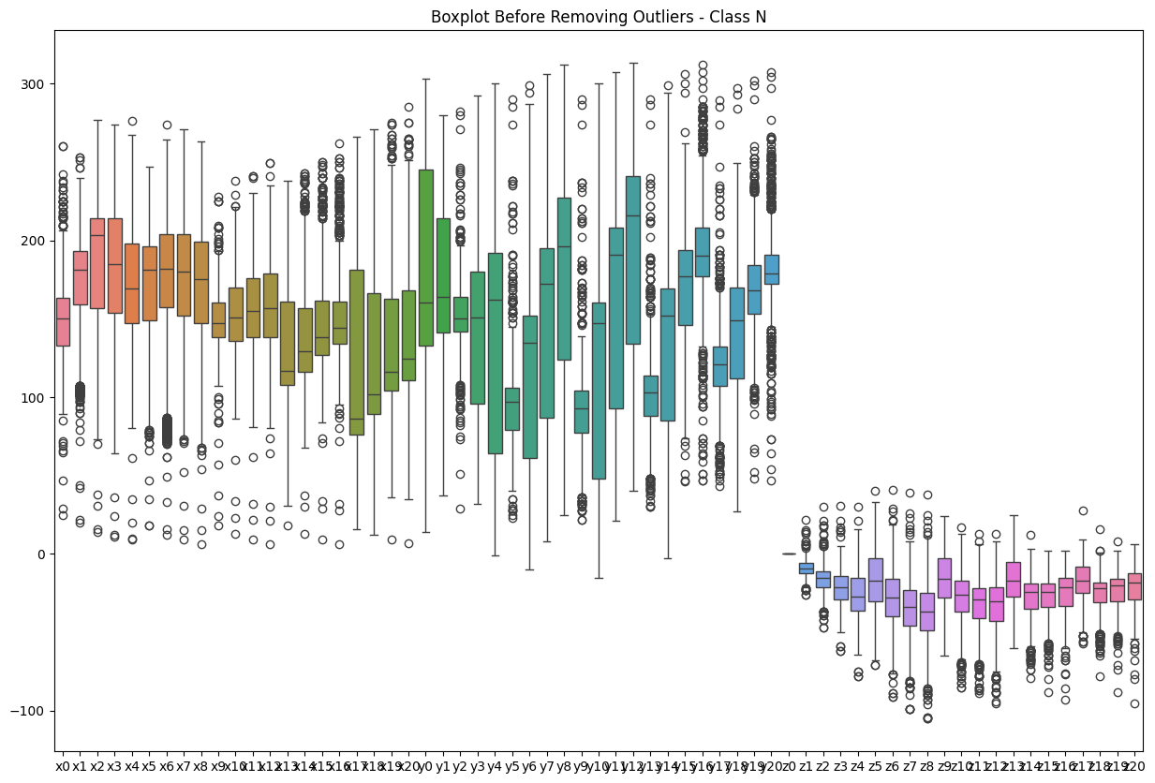
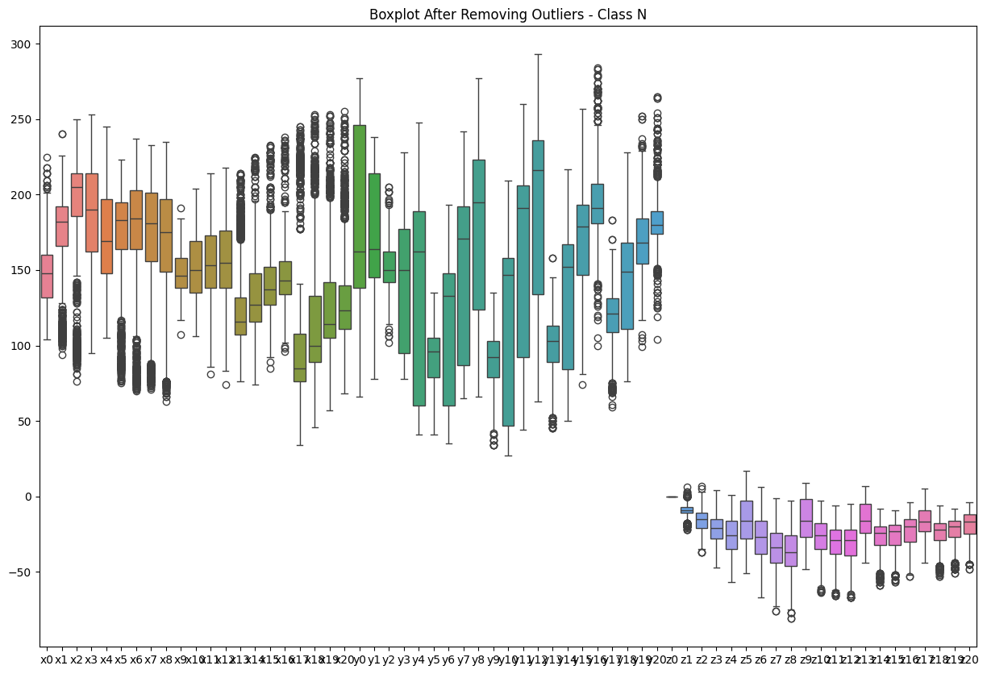
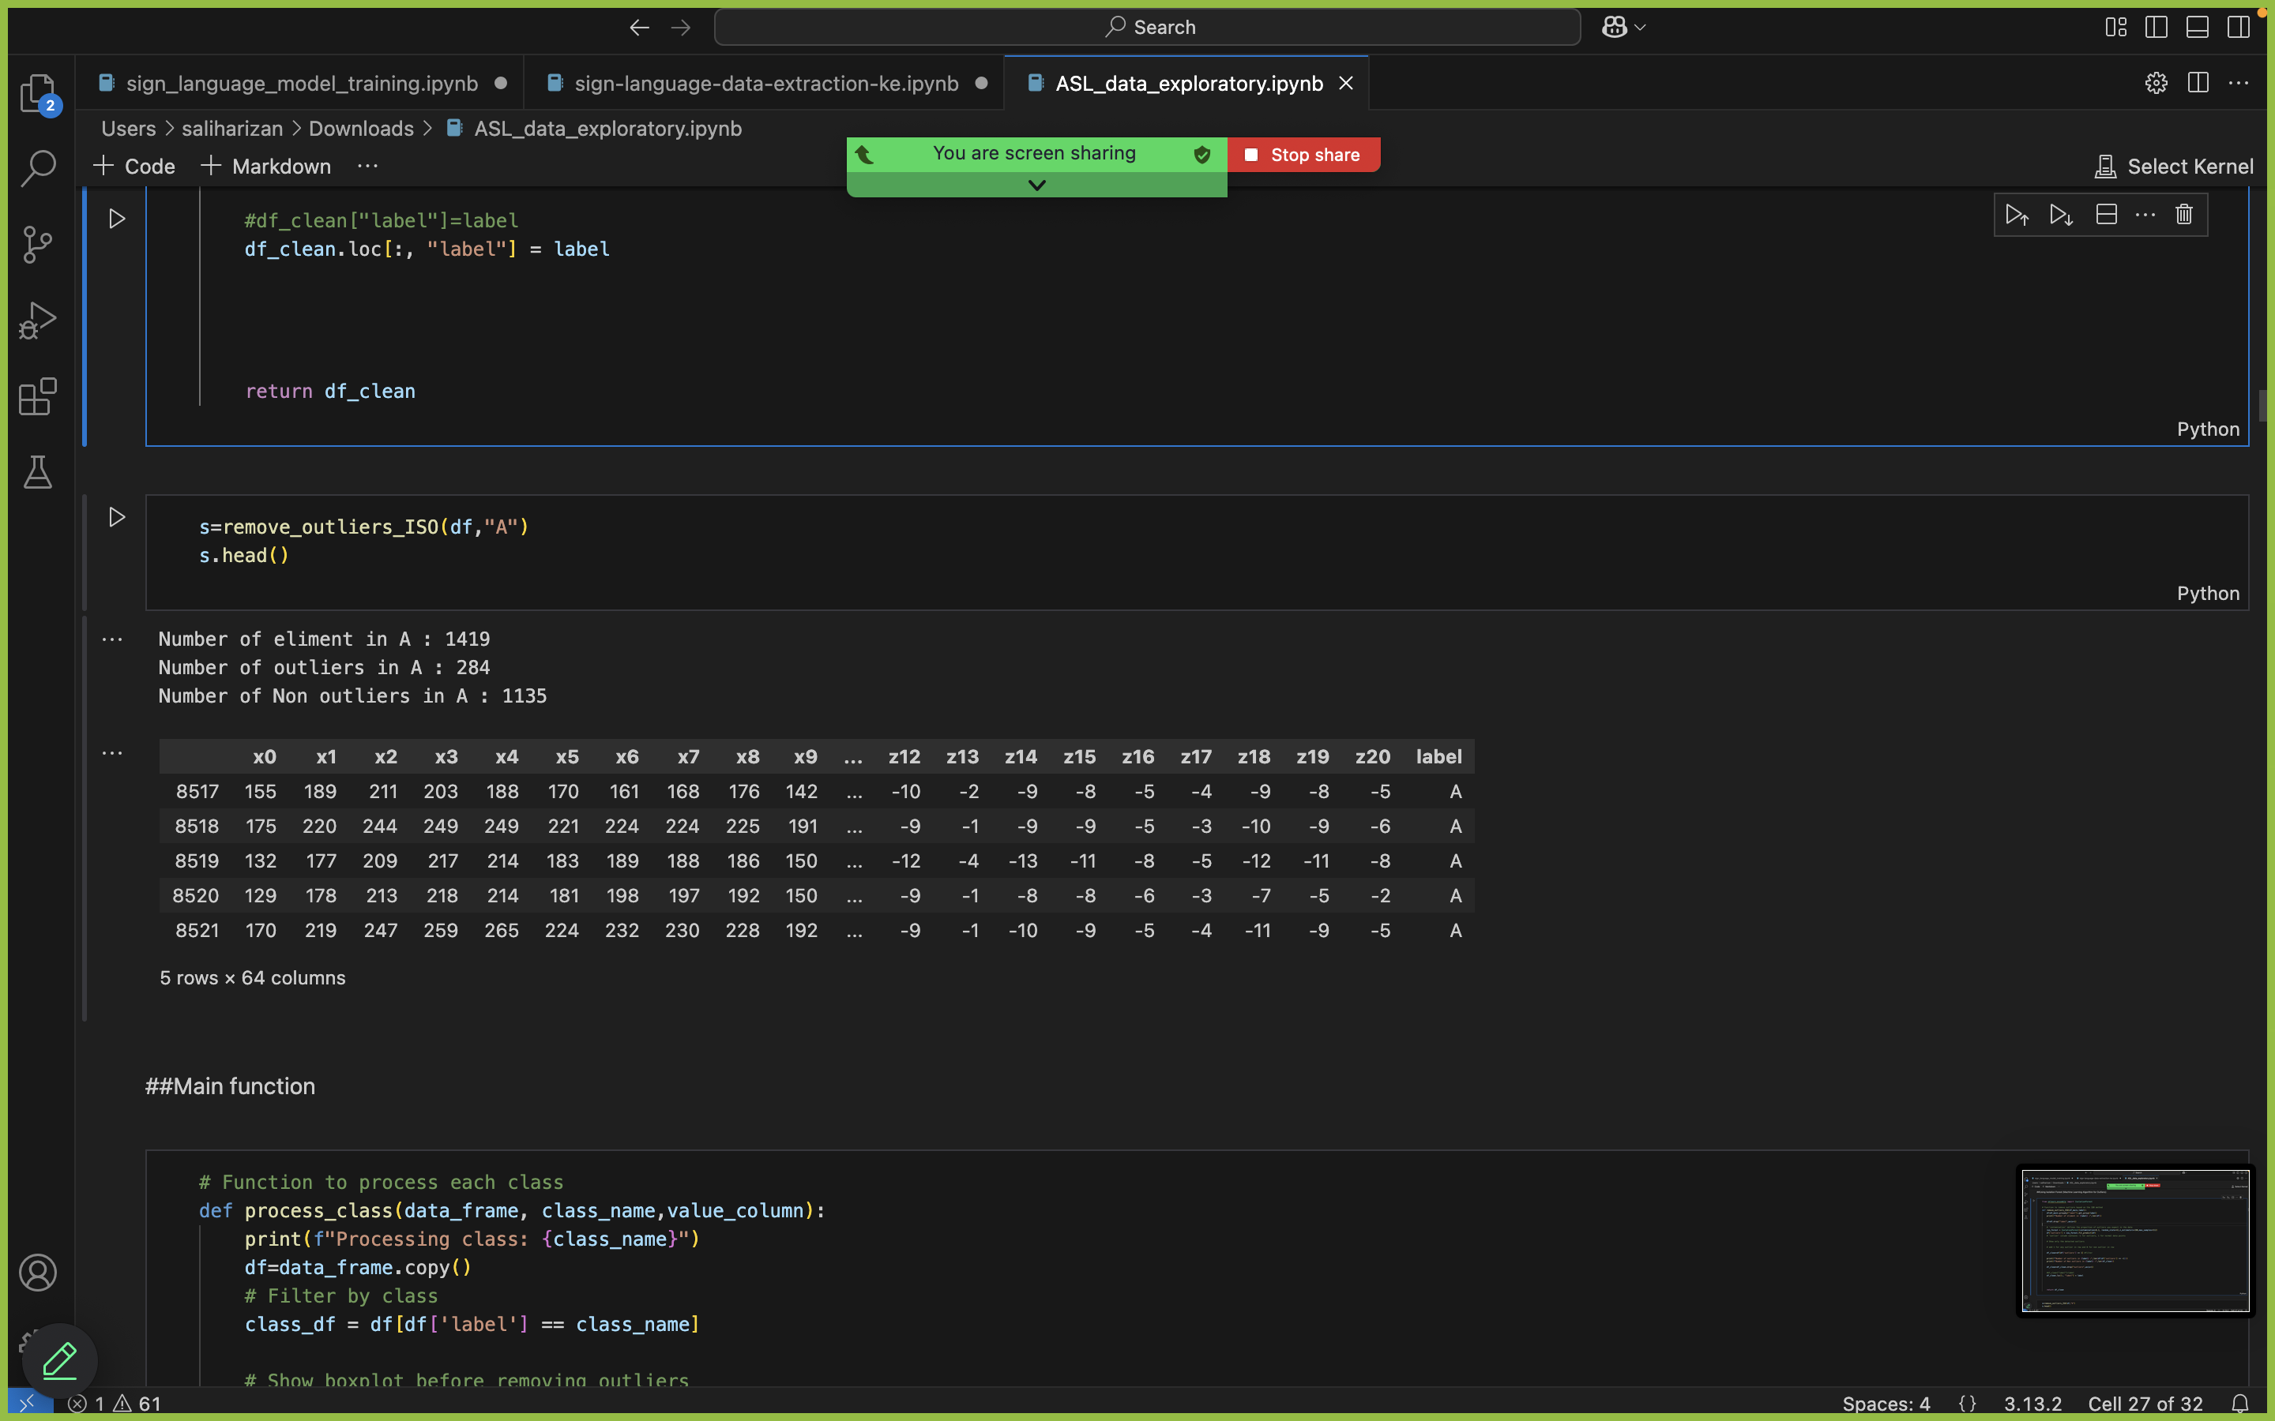
Data Preprocessing
Number of eliment in N : 1486
Number of outliers in N : 297
Number of Non outliers in N : 1189
Isolation Forest (Machine Learning Algorithm for Outliers)
Rizan S – IT21311840
Notes:
Here, I am explaining the process of removing outliers from the dataset using the Isolation Forest.
As shown in the image, I first use the Isolation Forest algorithm to detect outliers. The contamination parameter is set to define the proportion of outliers expected in the data. The algorithm then identifies and marks the outliers in the dataset.
The boxplots on the right show the data distribution before and after removing the outliers. On the left side, you can see the boxplot of the data with outliers still present, which shows extreme values. On the right, after removing the outliers, the boxplot now shows a cleaner distribution of data, which helps improve the accuracy of the model.
I filter the data to remove these outliers and then proceed to train the model on the cleaner dataset. This ensures that the model isn't affected by extreme or irrelevant data points, leading to better predictions.

Slide 21
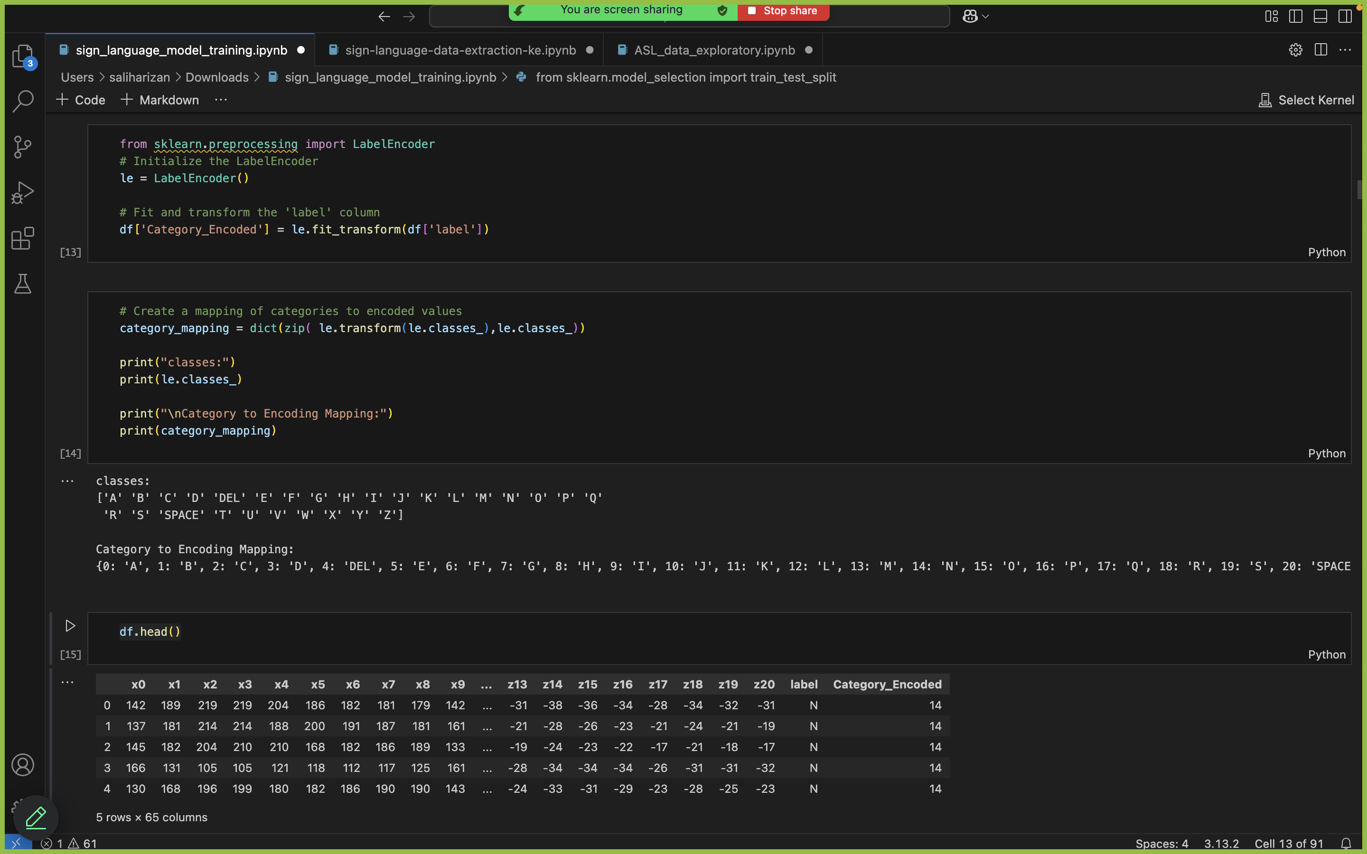
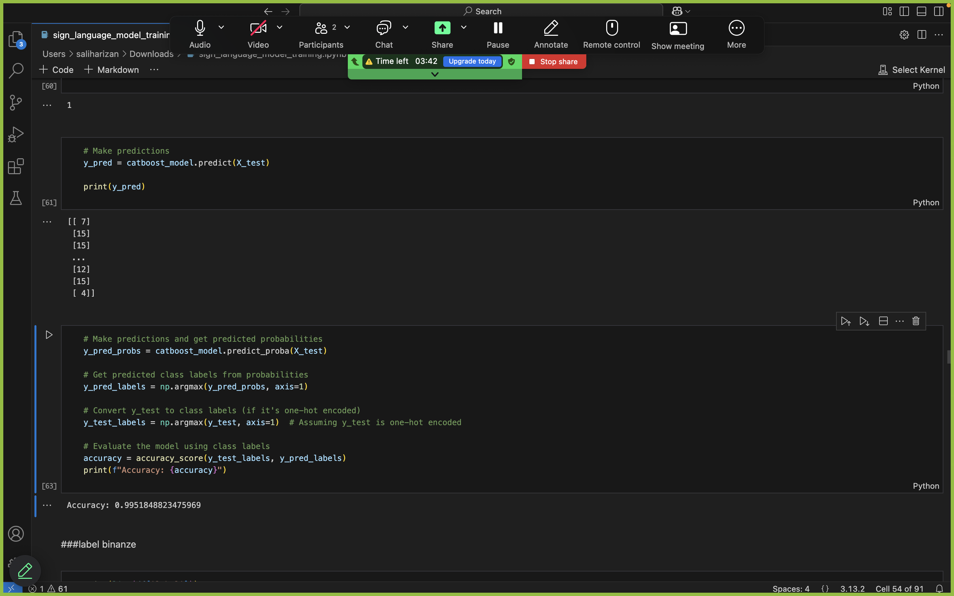
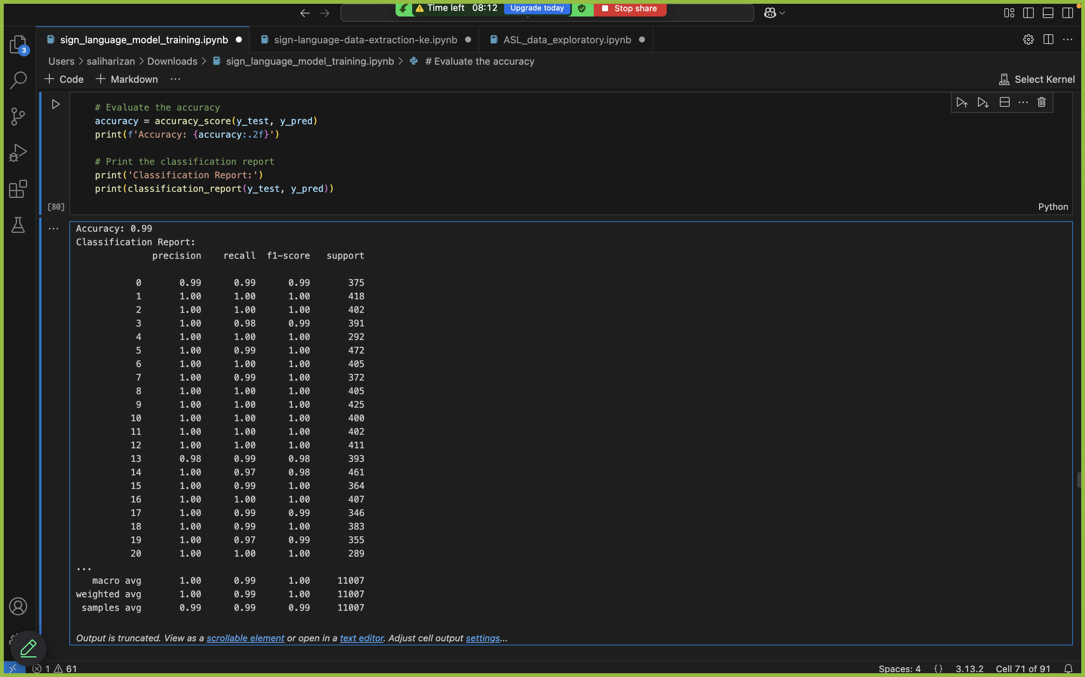
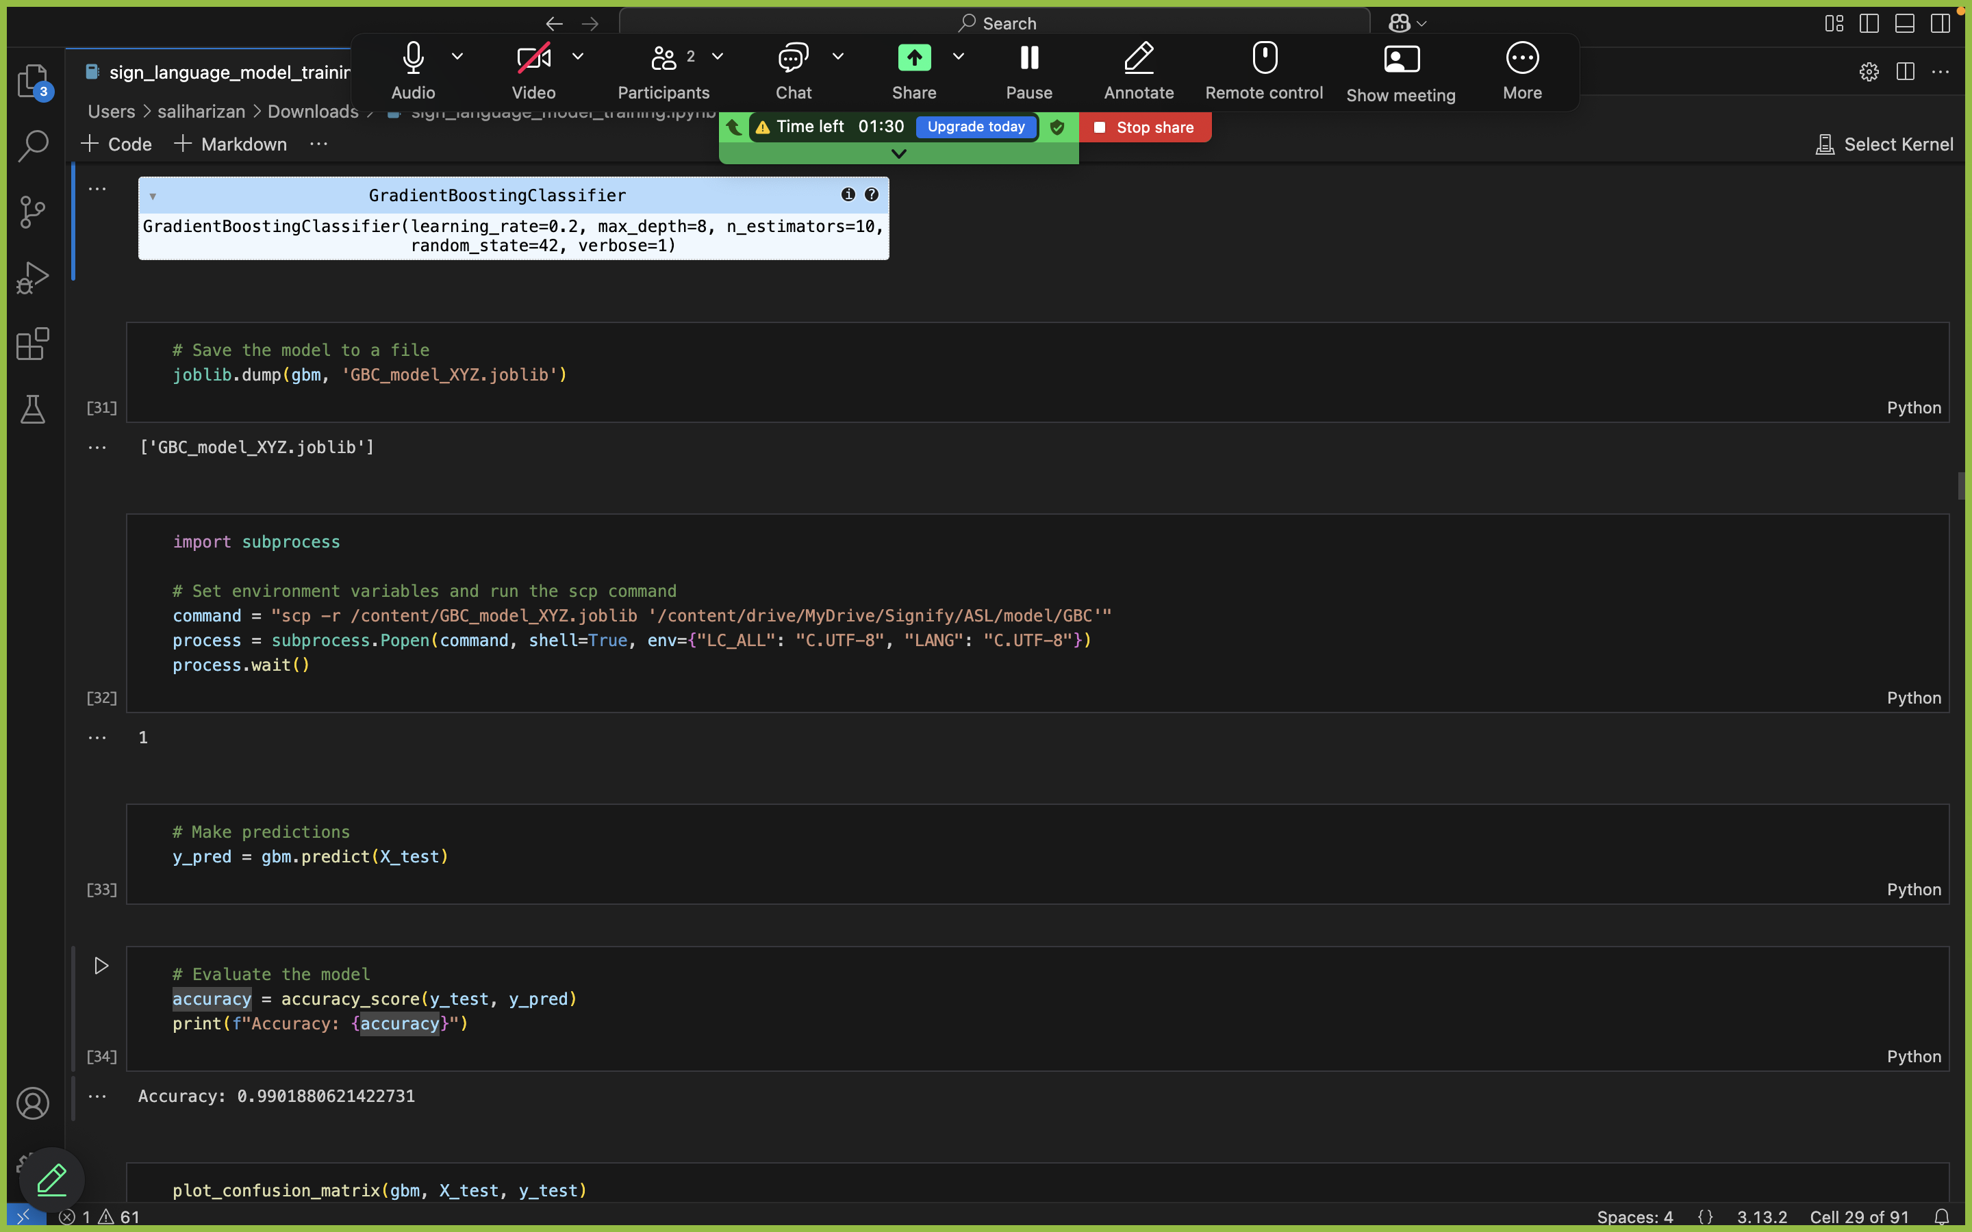
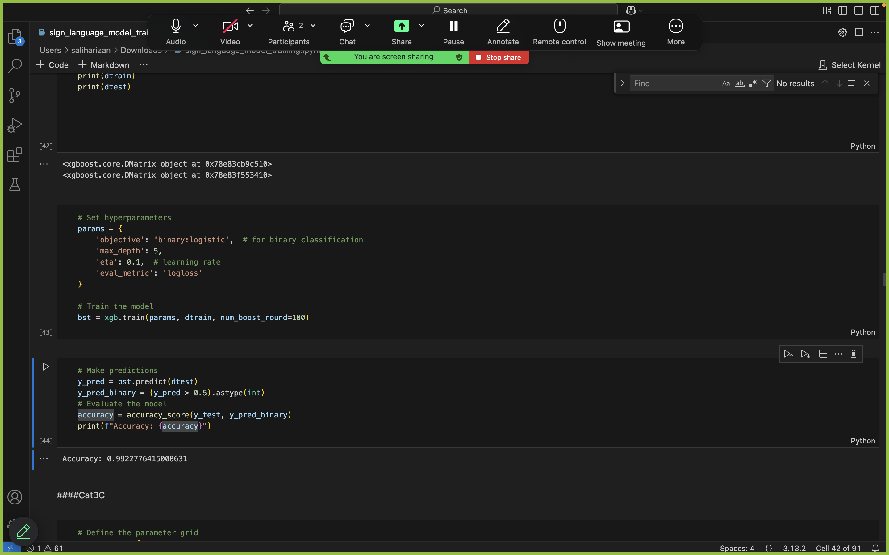
Model
t
CatBoost Classifier
Label Encoding
RandomForest Classification Report
Model | Accuracy
Random Forest Classifier (RFC) | 99.00%
Gradient Boosting Classifier (GBC) | 99.01%
XGBoost (XGB) | 99.22%
CatBoost | 99.51%
GradientBoostingClassifier
XGB
Rizan S – IT21311840
Notes:
Now, let me explain the model evaluation process and the results.
In this part of the system, I first encoded the labels using Label Encoding to prepare the data for model training. Once the data was prepared, I used various models such as Random Forest Classifier (RFC), XGBoost (XGB), Gradient Boosting, and CatBoost to train the system.
As shown in the results, I evaluated the models using accuracy score, and the performance of each model was quite impressive:
Random Forest Classifier (RFC) achieved an accuracy of 99.00%.
XGBoost (XGB) achieved an accuracy of 99.22%.
Gradient Boosting achieved an accuracy of 99.01%.
CatBoost, which I selected due to its high accuracy and speed, performed excellently with an accuracy of 99.51%.
After making predictions using the trained models, I checked the accuracy of the model on test data, and you can see the results here. The system's high accuracy indicates that it effectively recognizes ASL gestures and provides reliable feedback to users.
Random Forest Classifier: t creates many decision trees and combines their predictions. Each tree is trained on a different subset of the data, which helps improve accuracy and reduce overfitting.
XGBoost (Extreme Gradient Boosting): It builds decision trees one by one. Each tree tries to correct the mistakes made by the previous ones. It's very fast and efficient, and it's often used when high performance is needed.

Slide 22
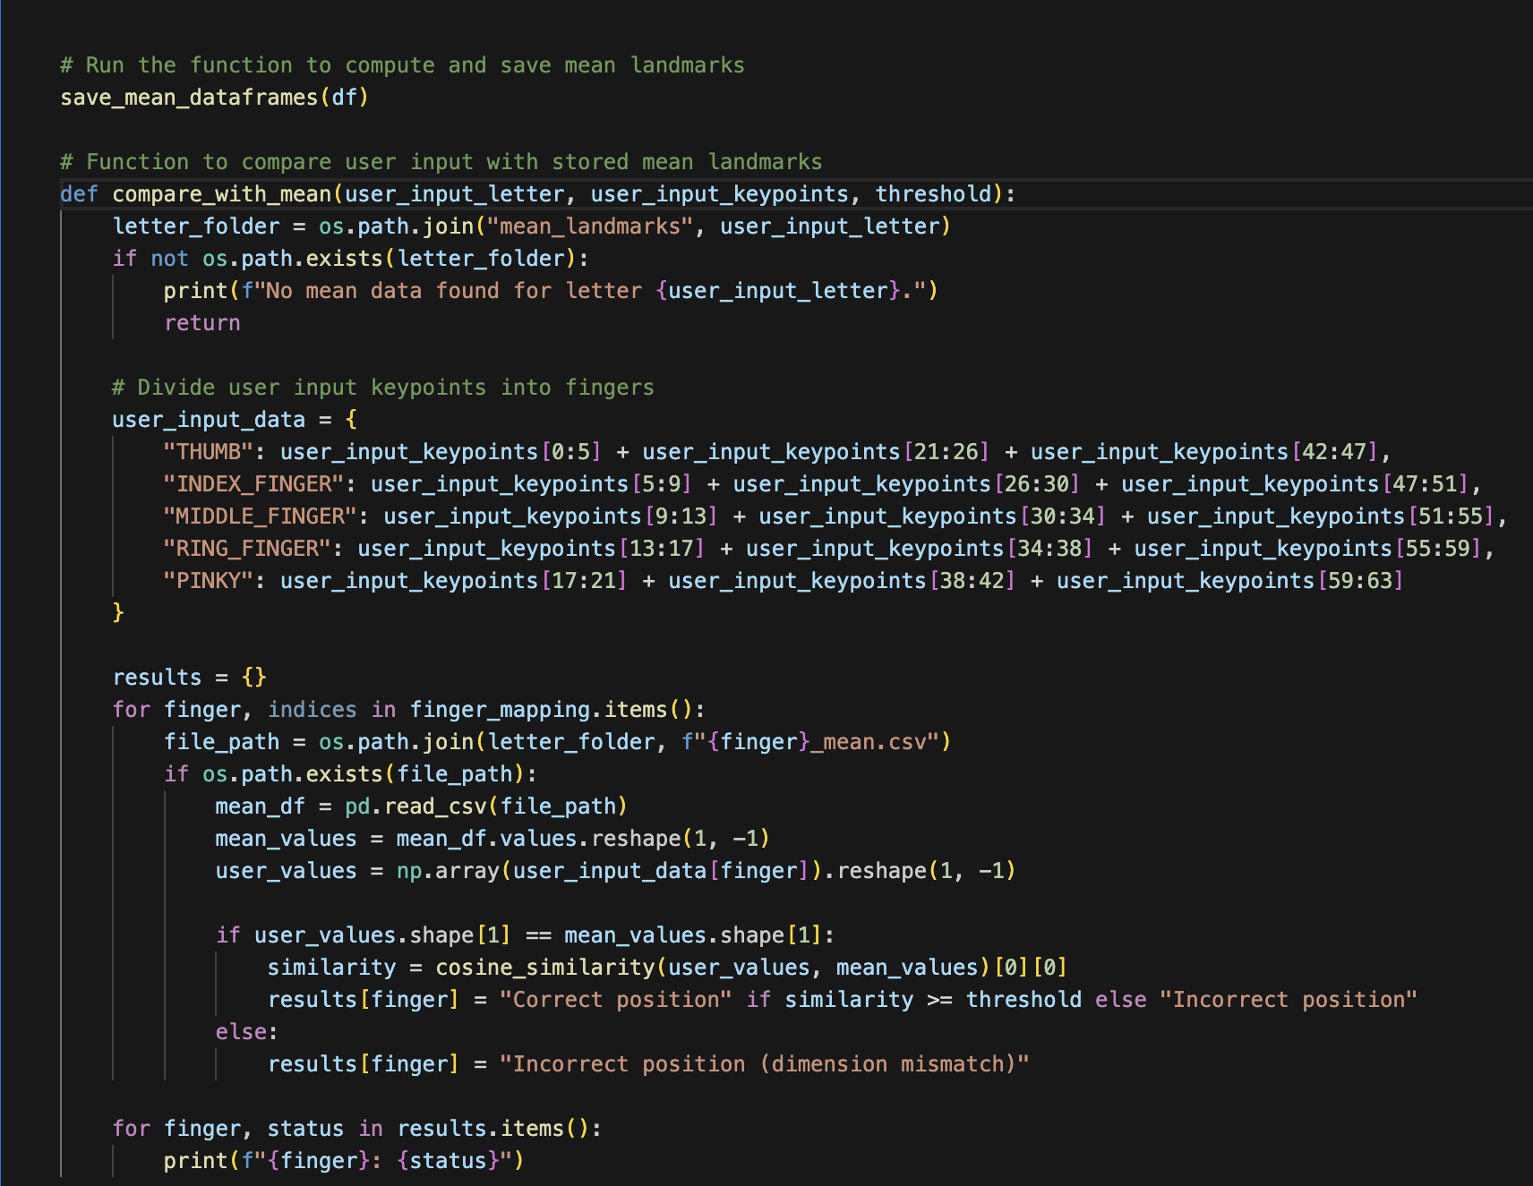
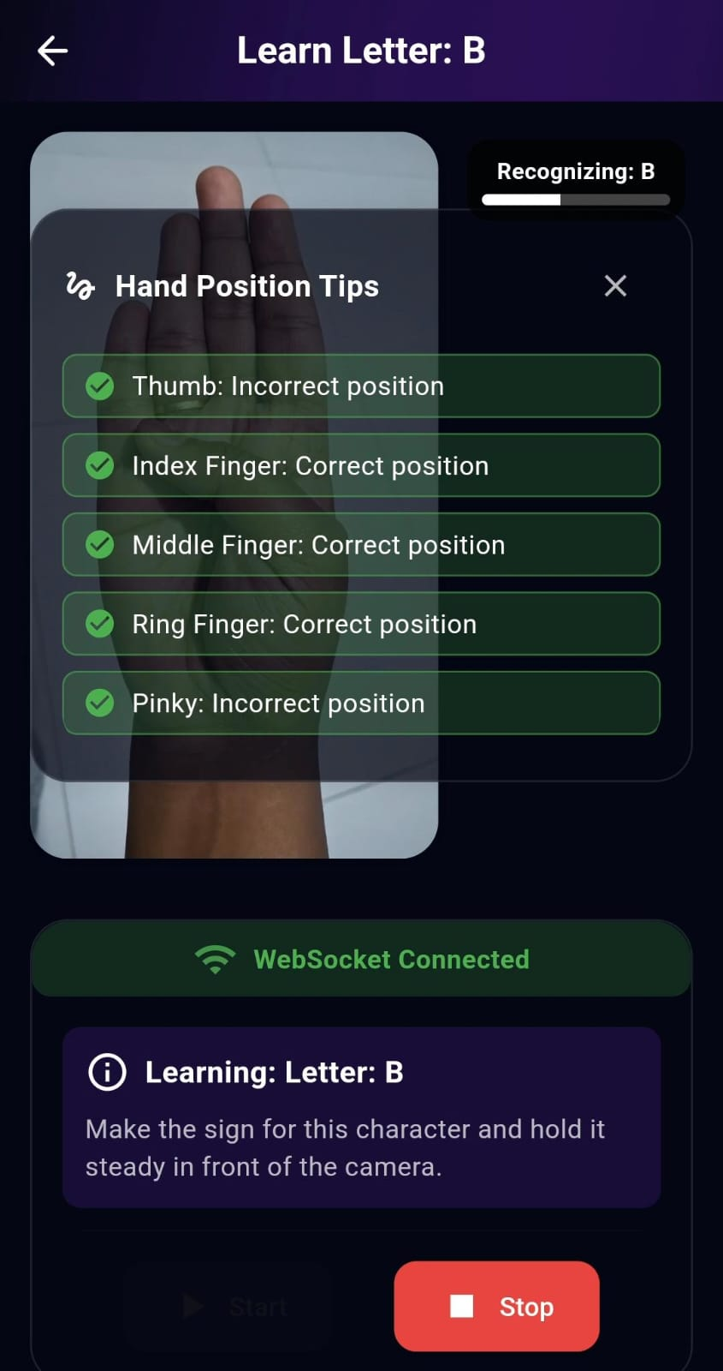
Error Detection
Rizan S – IT21311840
Notes:
Now, let's talk about error detection in the system.
In the image, you can see the process where we compare the user's hand position with the stored mean landmarks for each letter. The system takes the user's input, breaks it down into the 21 key points of the hand (divided into five sections: thumb, index, middle, ring, and pinky fingers), and then compares these key points with the pre-stored mean landmarks for each letter.
The comparison function uses cosine similarity to check if the user’s hand positions match the expected positions within a certain threshold. If the positions are close enough (based on cosine similarity), the system will display “Correct position” for that finger. Otherwise, it will show “Incorrect position” for that finger, as seen on the right side of the image.
In this example, the thumb and pinky are marked with incorrect position, while the index, middle, and ring fingers are recognized as correct. This feedback helps the user understand which parts of the gesture need adjustment to match the correct ASL sign."

Slide 23
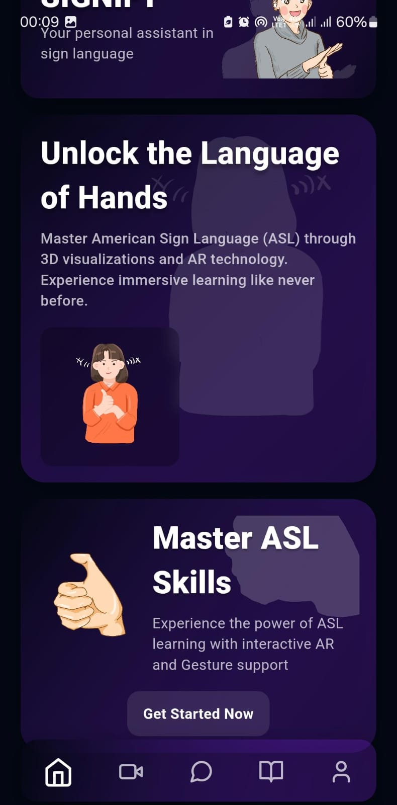
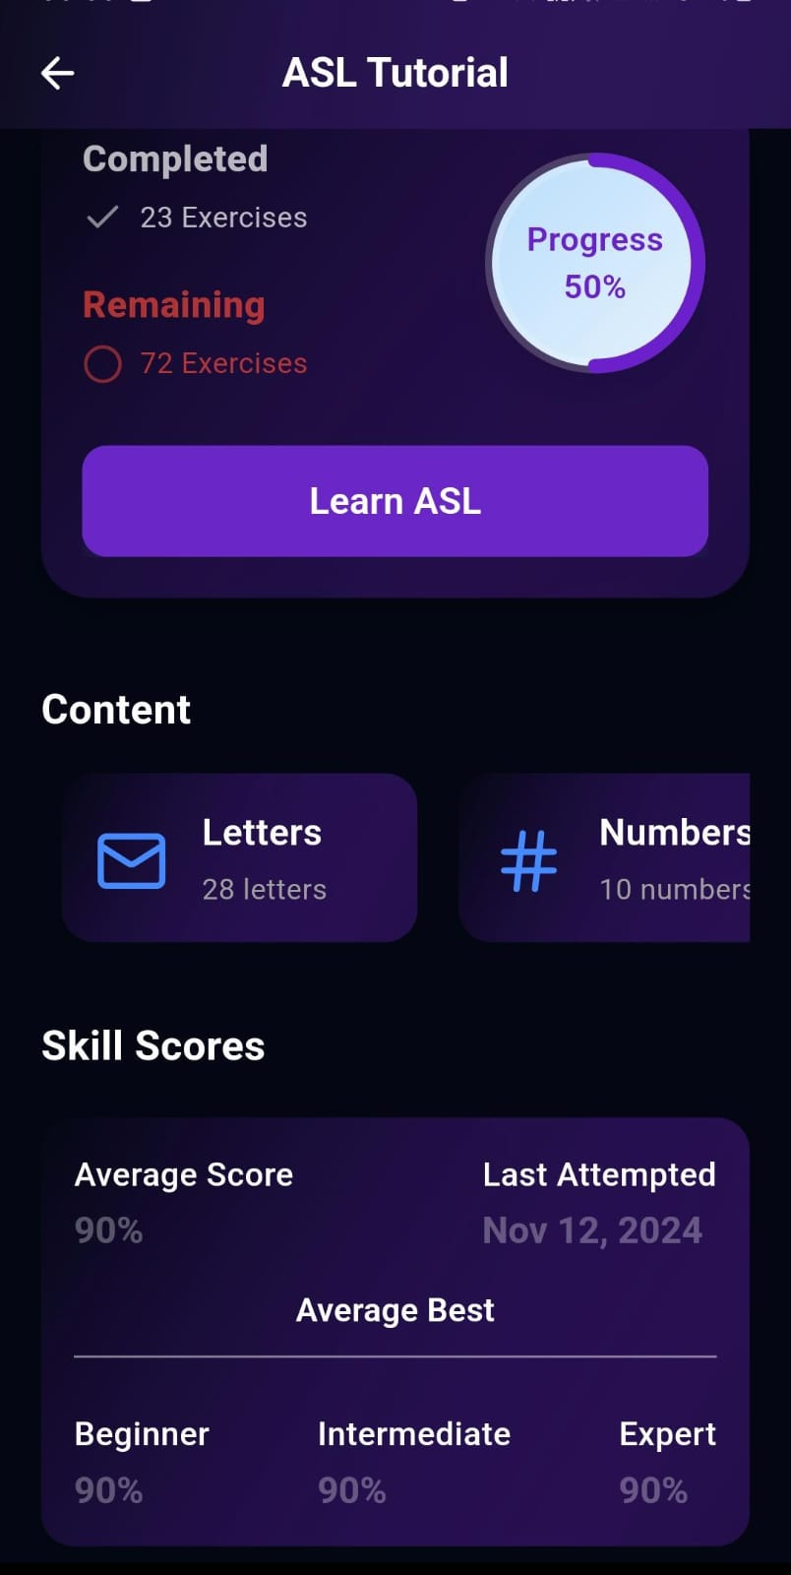
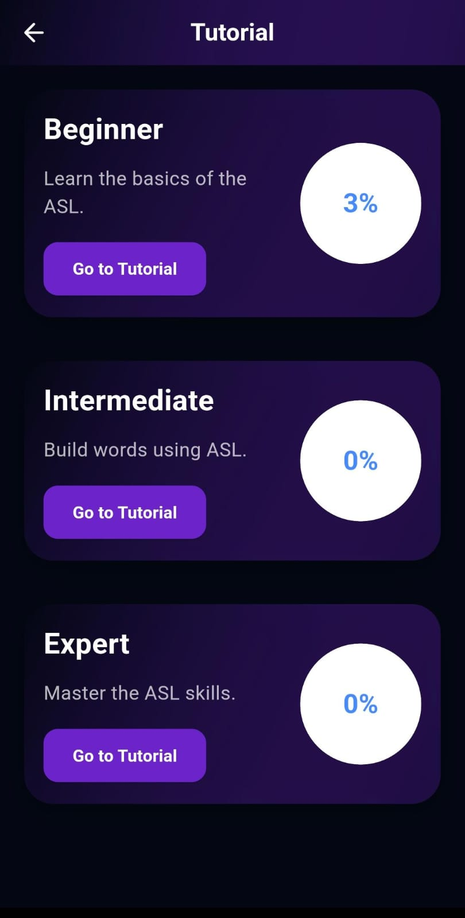
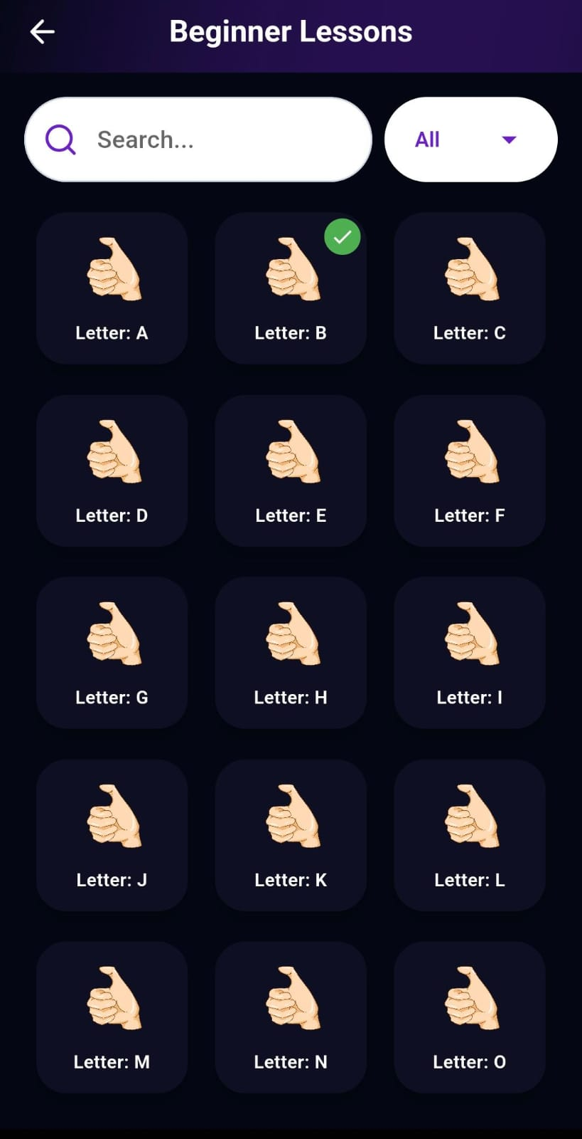
User Interface
Rizan S – IT21311840
Notes:
This app allows users to track their progress in learning ASL through three levels (Beginner, Intermediate, Expert), offering lessons on letters and numbers with 3D visualizations, AR technology, and progress bars to motivate and guide learners from basics to mastery.

Slide 24
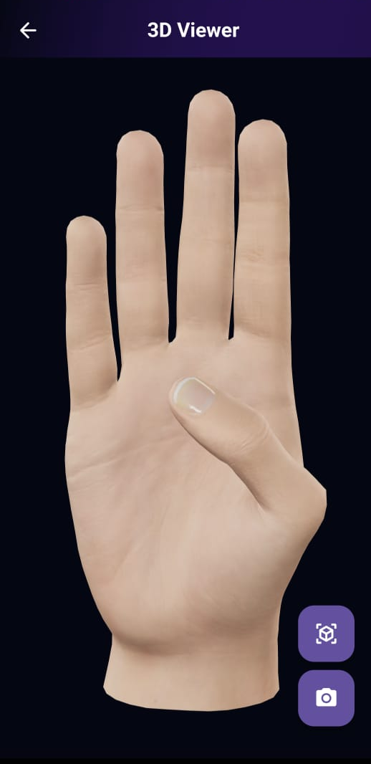
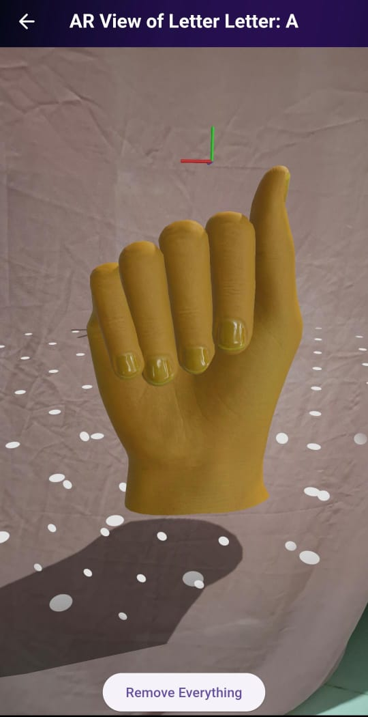
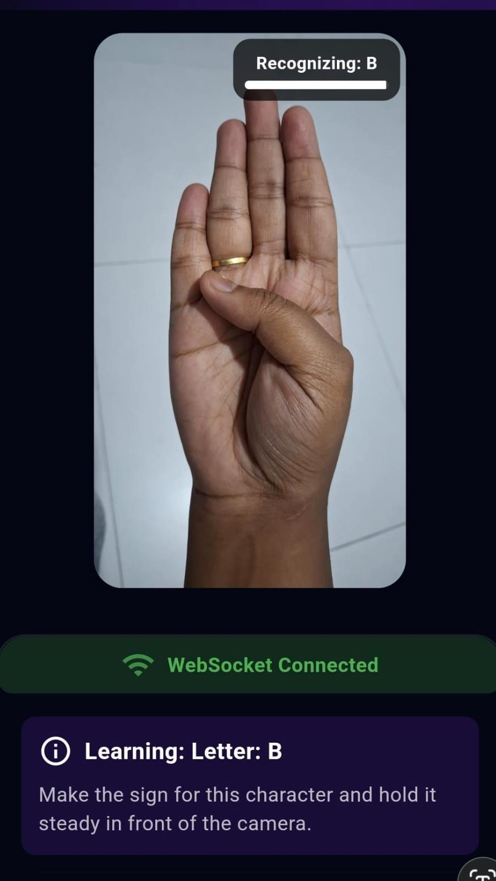
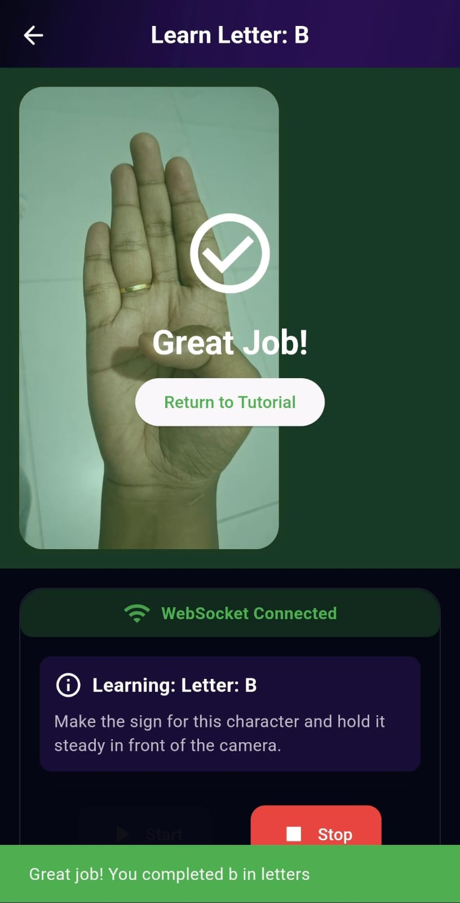
Rizan S – IT21311840
Notes:
The app uses augmented reality (AR) to display 3D hand models for ASL signs, provides real-time feedback on finger positions, and tracks the user's progress, encouraging them with a 'Great Job!' message once the correct sign is made.

Slide 25
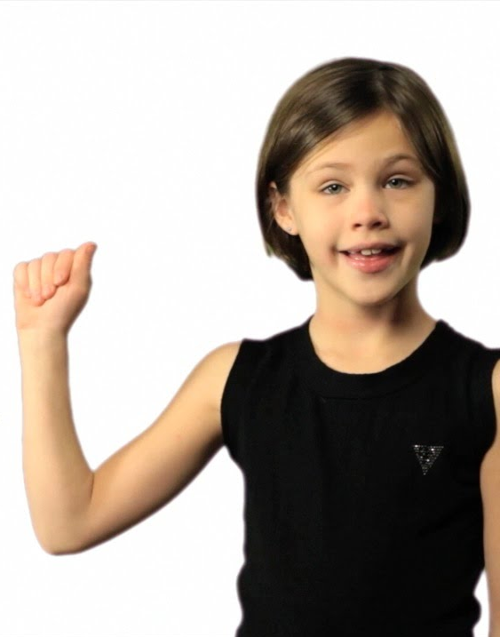
Requirements
Functional Requirements
Non - Functional Requirements
AR-based Gesture Recognition
Feedback System (Real-time Visual Feedback)
Proficiency Levels (Beginner, Intermediate, Advanced)
Activity and Assessment for Gesture Practice
High Performance
Graphics Processing
Network Reliability
Scalability
25
Rizan S – IT21311840
Notes:
Regarding the requirements:
The functional requirements include AR-based gesture recognition, real-time feedback, proficiency levels (Beginner, Intermediate, Advanced), and activity assessment for gesture practice.
The non-functional requirements focus on high performance, graphics processing, network reliability, and scalability.

Slide 26
References
[1] Kambhampati S. Sindhu, Mehnaaz, Biradar Nikitha, Penumathsa Likhita Varma, and Chandrasekhar Uddagiri, "Sign Language Recognition and Translation Systems for Enhanced Communication for the Hearing Impaired," in Proc. 1st International Conference on Cognitive, Green, and Ubiquitous Computing (IC-CGU), 2024, pp. 1-8.
[2] MMK Rowel, ADAI Gunasekara, GAI Uwanthika, and DB Wijesinghe, "An E-Learning Platform for Hearing Impaired Children," Faculty of Computing, General Sir John Kotelawala Defence University, Ratmalana, Sri Lanka, 2023.

Slide 27

Z.F Sahla - IT21159558
Specialization : Data Science
27
Z.F. Sahla - IT21159558

Slide 28

Function 3
AI-powered Learning Assistant with Sign Language Support & Recommendations with Performance Prediction
Z.F. Sahla - IT21159558

Slide 29
Research Problem
Lack of real-time performance analysis and future predictions for continuous improvement.
Lack of personalized learning tools for users based on their performance.
Difficulty in predicting improvement and recommending personalized resources.

Slide 30
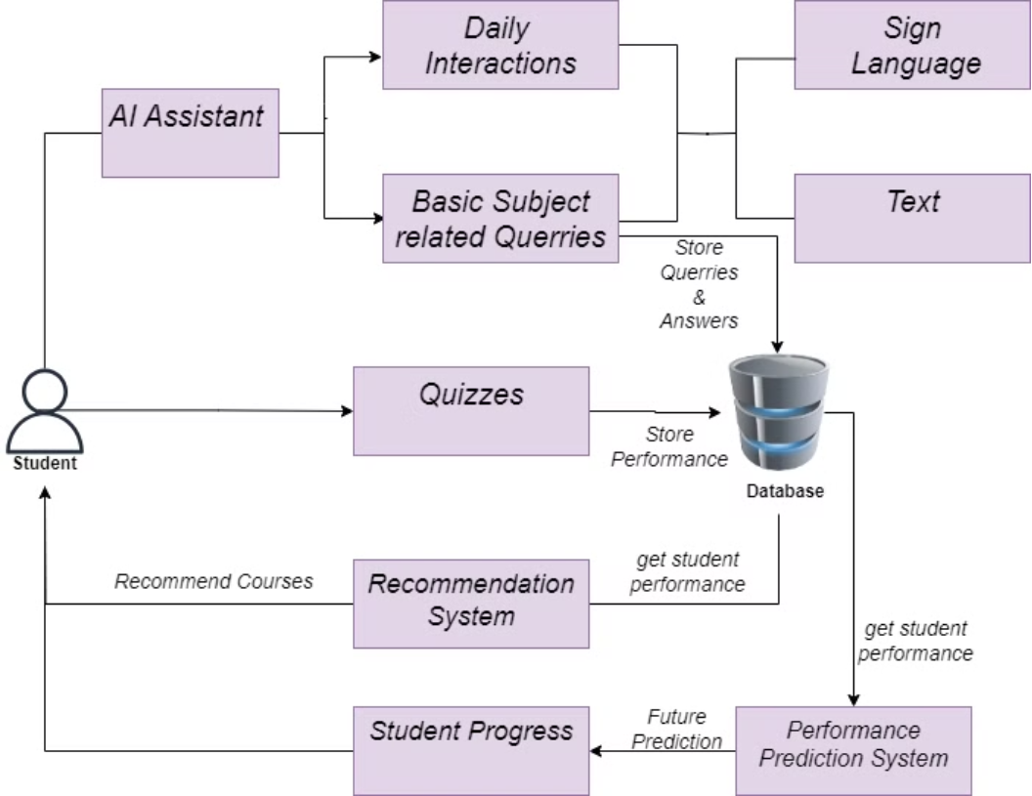
Component Diagram

Slide 31
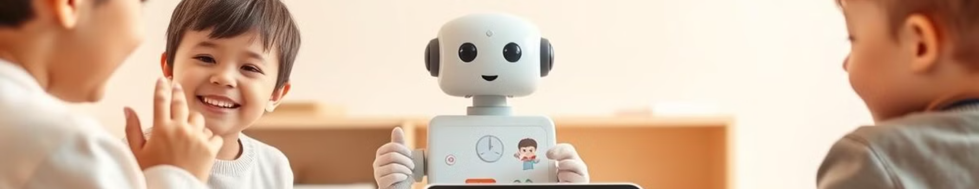
Main Objectives
1
Develop an AI-powered chatbot to provide interactive study assistance, making learning more engaging and personalized.
2
Implement a recommendation system that suggests personalized courses based on user scores and performance.
3
Build a system to predict future performance and track the improvement of users’ skills through game-based learning.

Slide 32
Sub Objectives
Chatbot
2
Recommendation System
Performance Prediction System
Develop an interactive chatbot for Mathematics and English queries.
Process user queries with TF-IDF and cosine similarity.
Use FastAPI for backend integration and handling user interaction.
Provide personalized course recommendations and feedback based on user history.
Recommend courses based on user level and subject.
Use predefined course datasets for recommendations.
Provide feedback based on user performance.
Apply cosine similarity for better course suggestions.
Calculate game score (XP) based on performance.
Predict future performance using machine learning models.
Use ARIMA for forecasting player engagement.
Offer real-time feedback on player progress.
1
3

Slide 33


Evidence of Completion

Slide 34
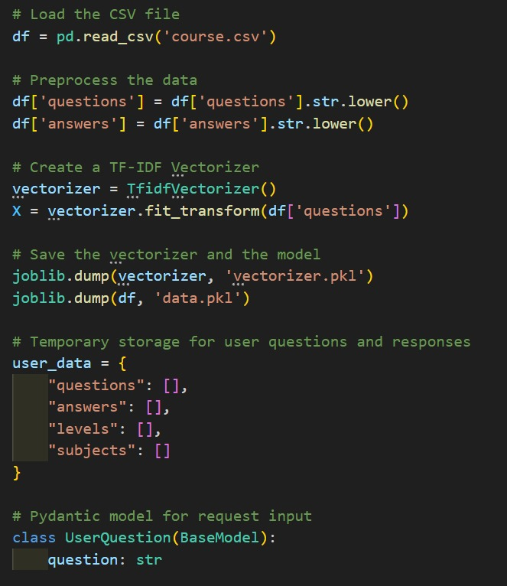
Data loading & Preprocessing

Slide 35
Chatbot
Z.F. Sahla - IT21159558

Slide 36
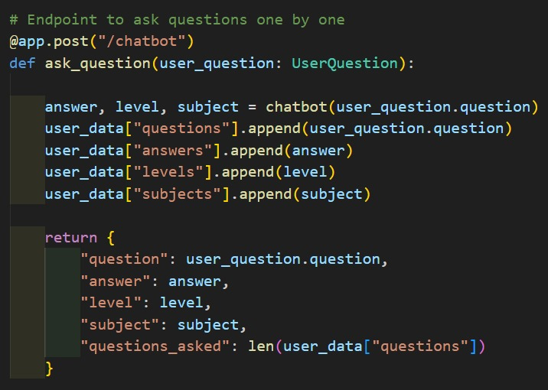
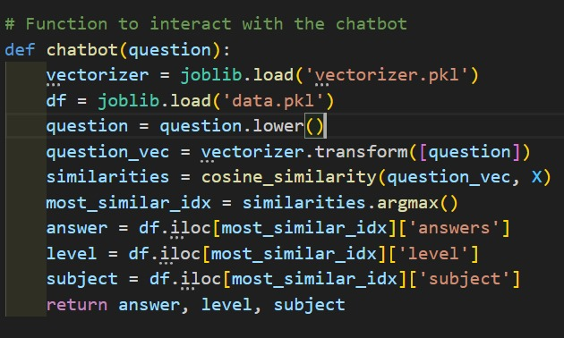

Slide 37
Recommendation System
Z.F. Sahla - IT21159558
\

Slide 38
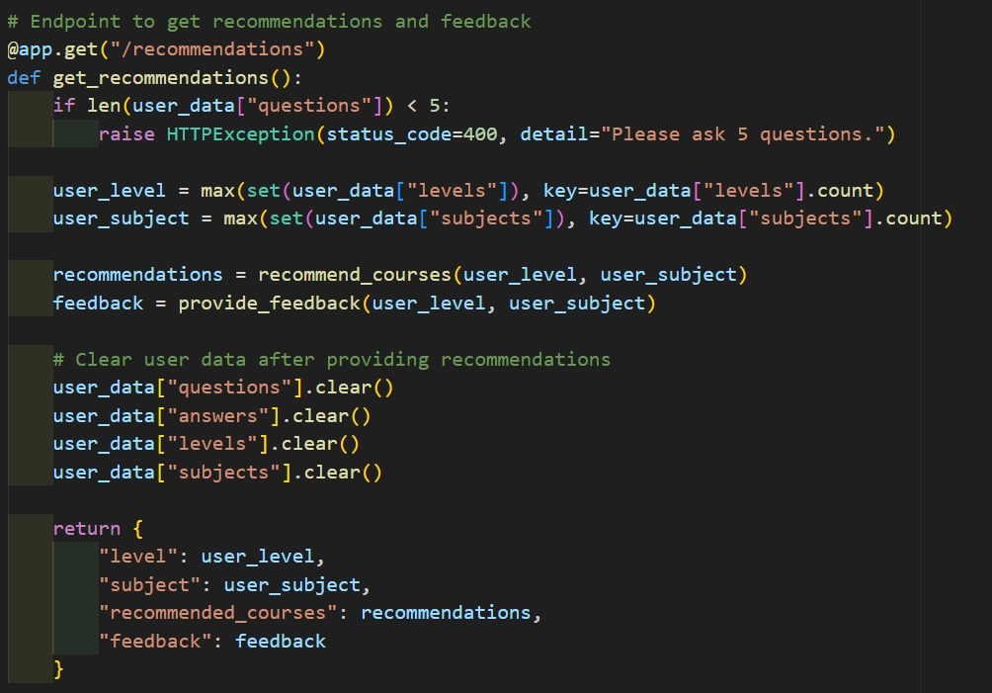
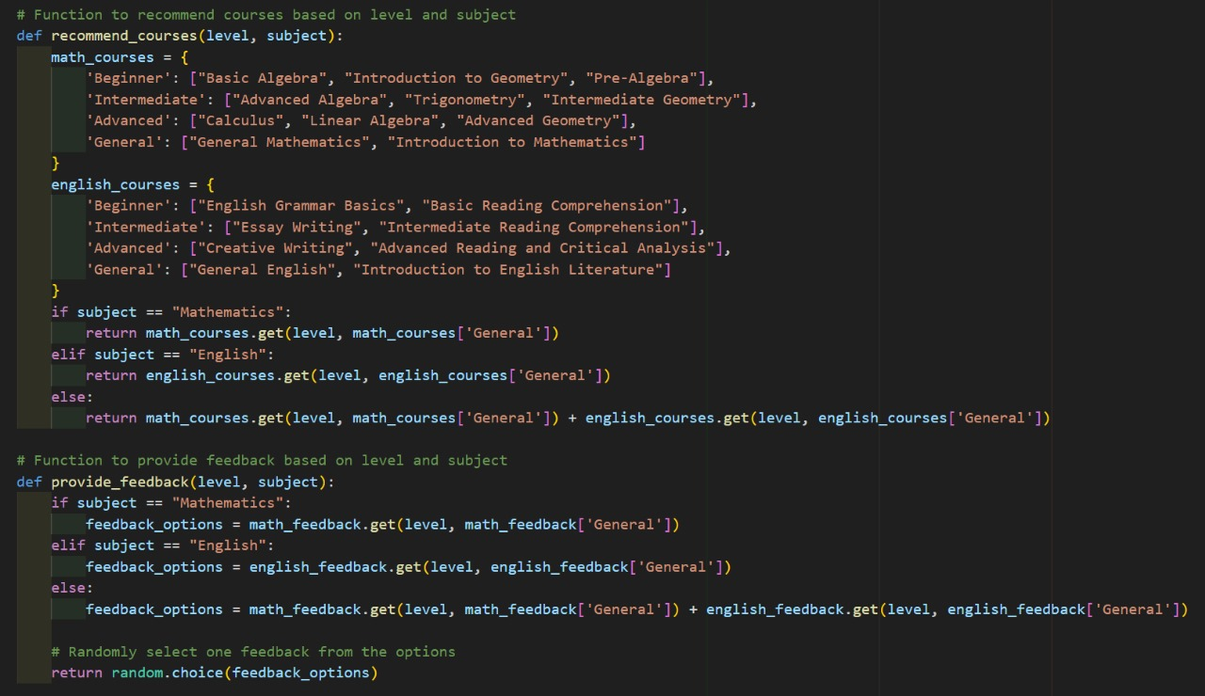
Chatbot based Recommendations and feedbacks

Slide 39
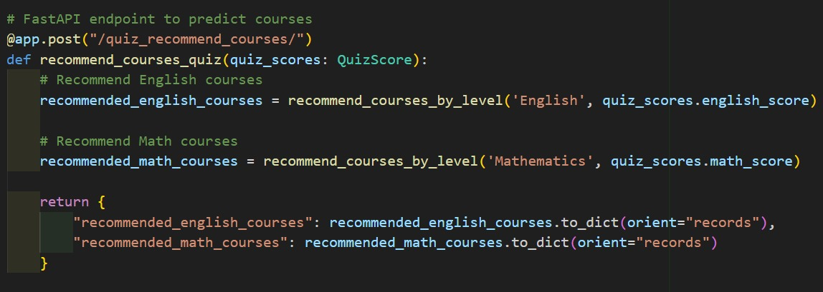
Quiz based Recommendations

Slide 40
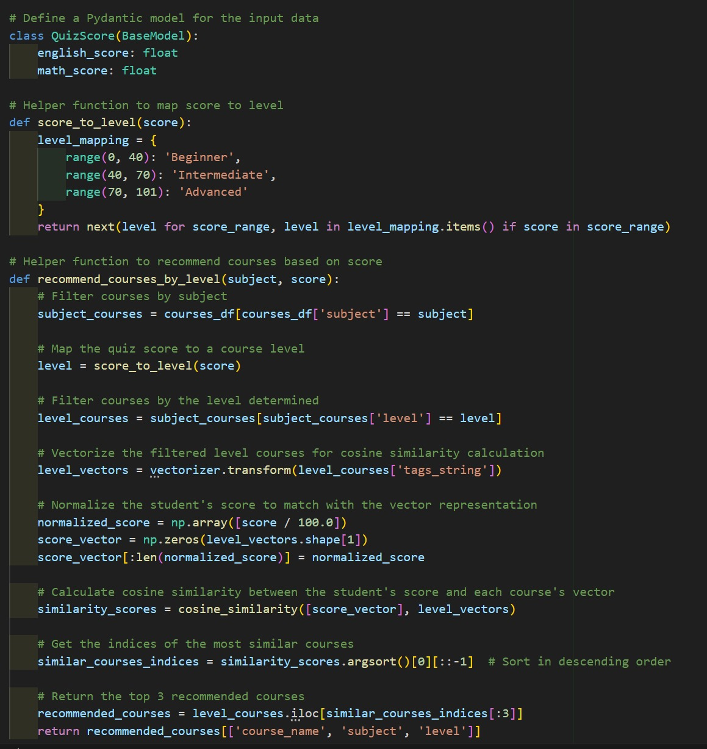

Slide 41
Performance Prediction System
Z.F. Sahla - IT21159558

Slide 42
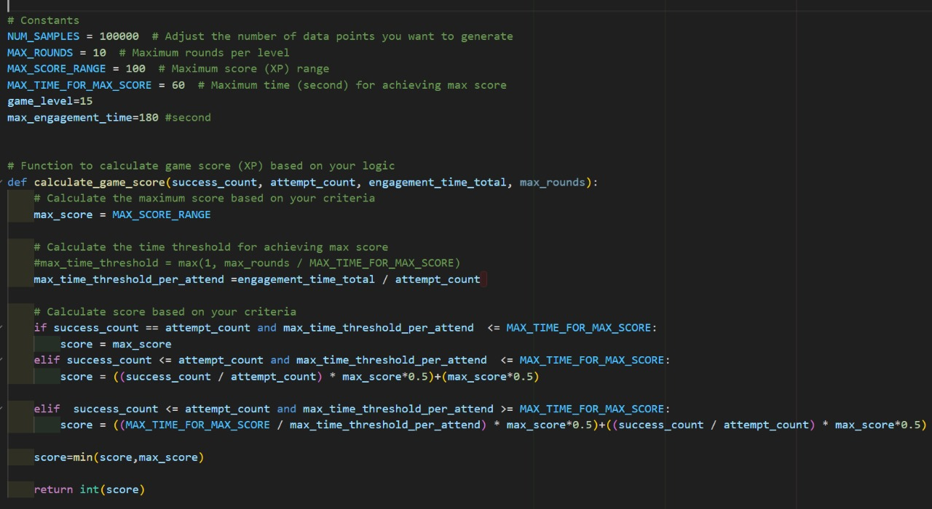
Game Score calculation

Slide 43
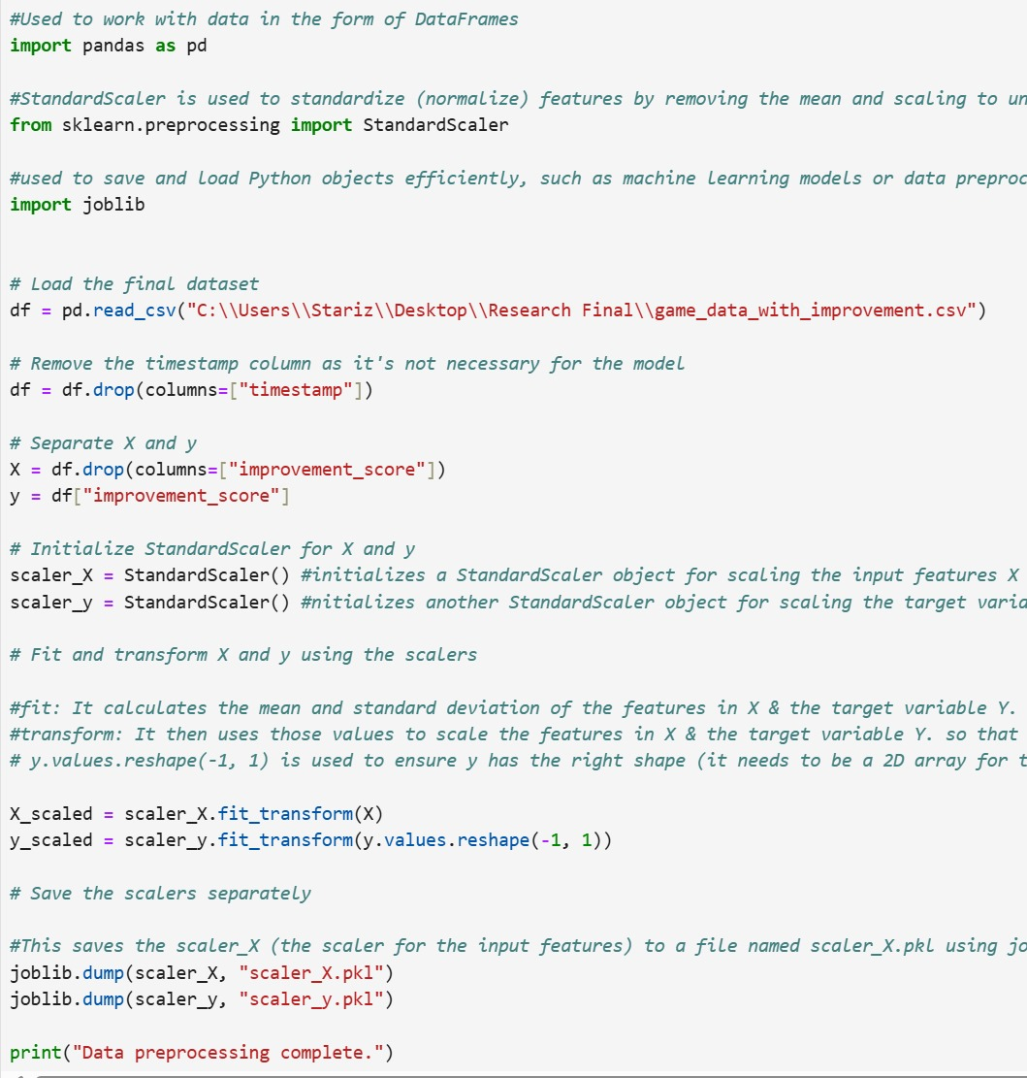
Data Preprocessing

Slide 44
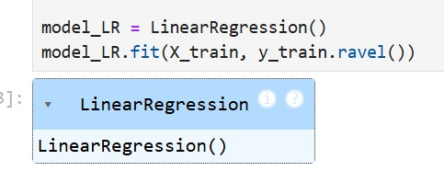
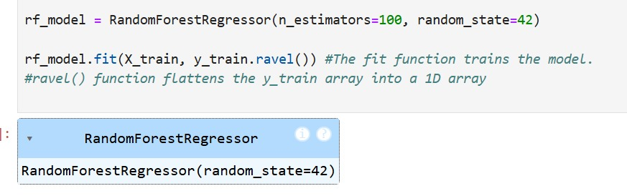
Models training

Slide 45
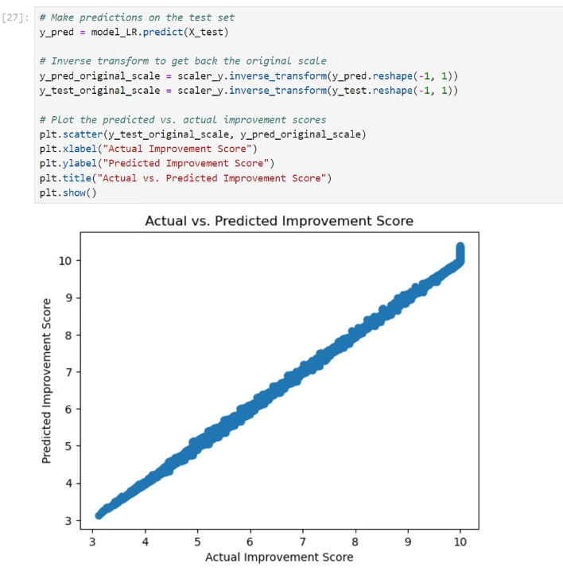
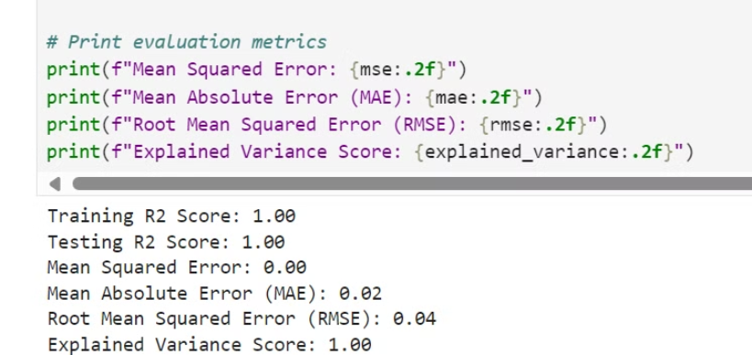
Improvement Score Prediction using Linear Regression model
Accuracy of the model

Slide 46
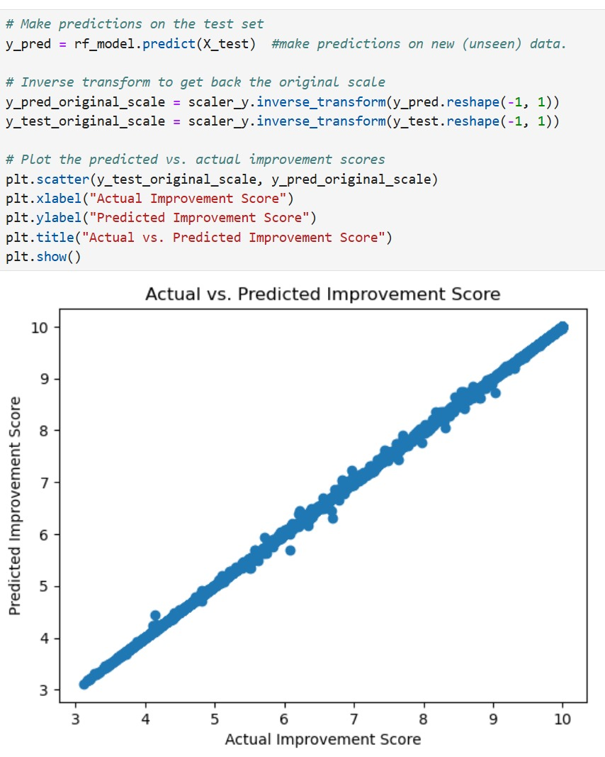
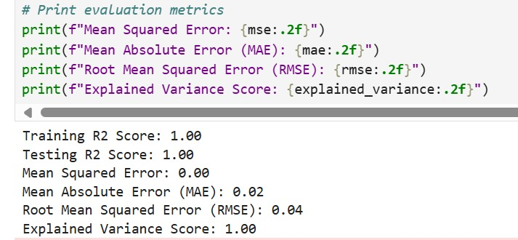
Improvement Score Prediction using Random Regression model
Accuracy of the model

Slide 47
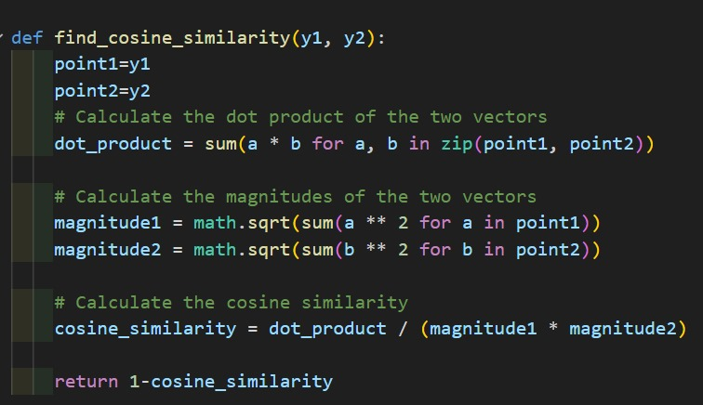
Cosine Similarity

Slide 48
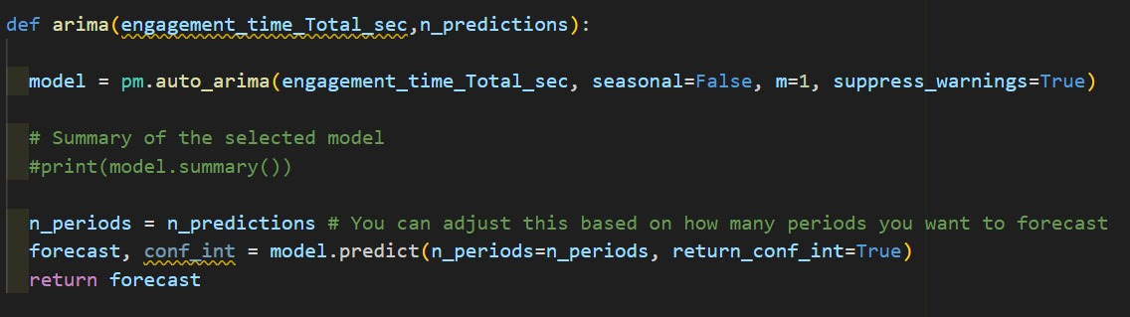
Time series forecasting with ARIMA

Slide 49
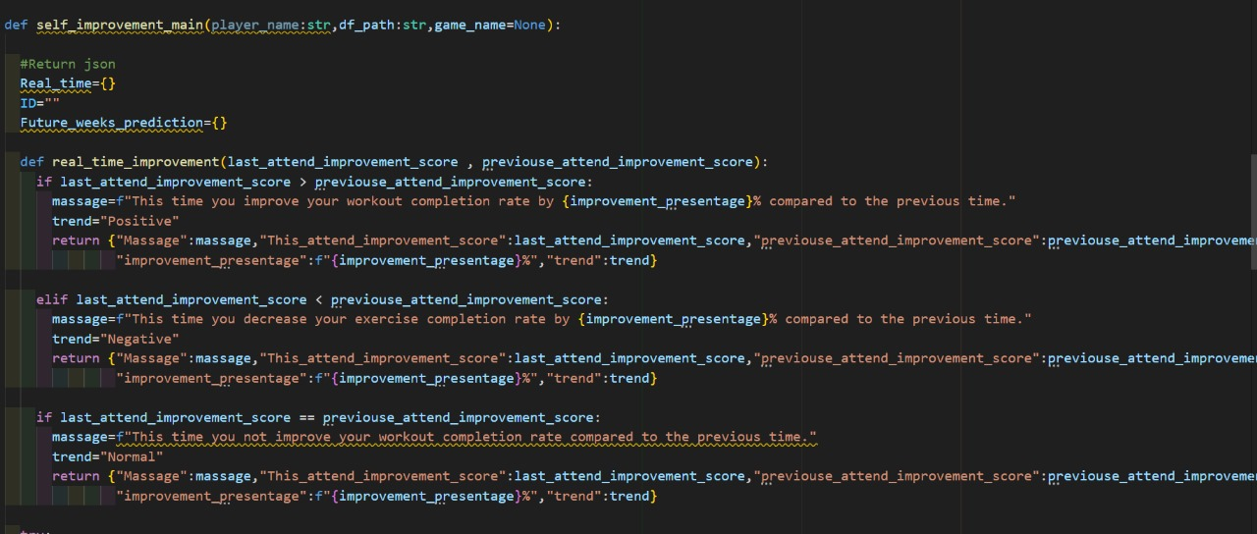
Real time feedback generation

Slide 50
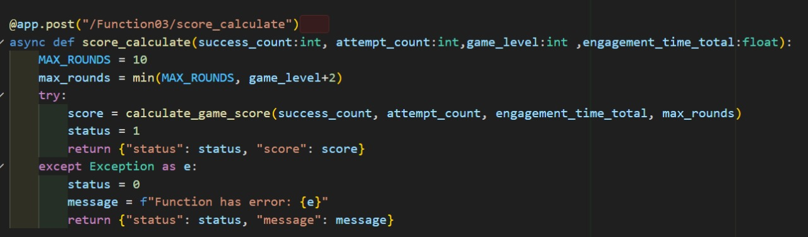

Score calculation & Self Improvement endpoints

Slide 51

Model Interference & Predictions

Slide 52
UI designs

Slide 53





Slide 54




Slide 55
Technologies
1
Chatbot
2
Recommendation System
3
Performance Prediction System
Libraries
Libraries
FastAPI
FastAPI
Libraries
Pydantic
scikit-learn (TF-IDF)
pmdarima (ARIMA)
HTTPException
Cosine Similarity
scikit-learn
Pandas
Joblib
Joblib
Pandas
NumPy
Matplotlib

Slide 56
System & Software Requirements
Hardware
Software
Cloud Infrastructure
Minimum 4GB RAM
Python 3.x
For real-time data: Firebase setup for data storage
CPU: Intel i5 or higher for moderate load
Libraries: scikit-learn, pmdarima, FastAPI, joblib, pandas, numpy
Storage: 10GB free space for development and model storage
IDE: VS Code, Jupyter Notebook

Slide 57

References
Koren Koren, Y., Bell, R., & Volinsky, C. (2009). Matrix Factorization Techniques for Recommender Systems. IEEE Computer Society. DOI: 10.1109/ICDM.2009.124
Karatzoglou, A., et al. (2019). A Survey on Deep Learning for Recommender Systems. ACM Computing Surveys. DOI: 10.1145/3293663
Siegel, E. (2013). Predictive Analytics: The Power to Predict Who Will Click, Buy, Lie, or Die. Wiley.
LeCun, Y., Bengio, Y., & Hinton, G. (2015). Deep Learning. Nature, 521(7553), 436-444. DOI: 10.1038/nature14539
Z.F. Sahla - IT21159558

Slide 58

MSM Shazny - IT21173622
Specialization : Data Science
Real-Time Translation of Educational Content to captions, sign language and providing summary.
58
MSM Shazny - IT21173622

Slide 59
Background
Hearing-impaired students face barriers in traditional e-learning environments due to auditory-based content.
Limited integration of sign language and captions in real-time on a single platform.
Need for inclusive tools to enhance accessibility and learning outcomes.
59
MSM Shazny - IT21173622

Slide 60
Research Gap
Existing solutions either focus on captions or sign language but rarely integrate both in real-time.
Lack of advanced AI for accurate, context-aware sign language animations.
Limited platforms offering real-time synchronization of captions, sign language, and video playback​
MSM Shazny - IT21173622

Slide 61
Specific & Sub Objectives
Develop a real-time system that converts educational video audio into synchronized captions, sign language, emotion detection, and provides video content summarization.
Implement real-time speech recognition to generate accurate captions from educational video audio.
Translate the transcribed captions into synchronized sign language animations for accessibility.
Detect and display emotions from the audio to enhance viewer engagement and understanding.
Summarize the video content at the end to provide key takeaways and highlights.
61
MSM Shazny - IT21173622

Slide 62

System Diagram
MSM Shazny - IT21173622

Slide 63
Technologies Used
Estimated Technologies
Model – CNN, LSTM, T5
Mobile Application - Flutter
Database - Firebase
Server - Fast API
General Environment
Python
Google Colab
Github
63
MSM Shazny - IT21173622

Slide 64
Implementation
MSM Shazny - IT21173622

Slide 65



Speech to text
MSM Shazny - IT21173622

Slide 66

Emotion
Load yamnet model
Audio preprocessing pipeline
Load audio → convert to tensor → extract embeddings with YAMNet → encode labels → prepare data arrays
MSM Shazny - IT21173622

Slide 67



ANN Model
MSM Shazny - IT21173622

Slide 68



CNN
MSM Shazny - IT21173622

Slide 69

Text base emotion
LSTM
Accuracy : 0.9250
Precision : 0.9330
Recall : 0.9172
MSM Shazny - IT21173622

Slide 70



Text Summarization
Rizan S – IT21311840

Slide 71




User Interface
Rizan S – IT21311840

Slide 72
Requirements
Functional Requirements
Non - Functional Requirements
The system shall synchronize the display of sign language gestures with the spoken content and captions in real-time
The system shall integrate these summaries with sign language translations and captions for comprehensive learning support.
The system shall provide a user-friendly interface that allows easy navigation between captions, sign language translations, and summaries.
Scalability
Reliability and Availability
Security
72
Rizan S – IT21311840

Slide 73
References
[1] "An E-Learning Platform for Hearing Impaired Children," details the limitations of current systems in integrating captions and sign language.
[2] "Sign Language Recognition and Translation Systems for Enhanced Communication for the Hearing Impaired," discusses the need for more advanced AI techniques in sign language translation.
[3] "E-Learning Model to Identify the Learning Styles of Hearing-Impaired Students," highlights the absence of integrated summarization tools in educational platforms for hearing-impaired students.
[4] "Hastha Online Learning Platform for Hearing Impaired," underscores the challenges in scaling and adapting systems to various educational environments.

